Slide 1


SUMMARY REPORT - INDUSTRY IMPACT, RESPONSE AND LESSONS LEARNED FROM THE
COVID-19 PANDEMIC
August 2020

Slide 2
TABLE OF CONTENTS
Page Number
  Executive Summary 3
  Industry Impact 8
  Survey Findings 10
  Lessons Learned 37
  Conclusions 48
  Suggested Next Steps 50

Slide 3
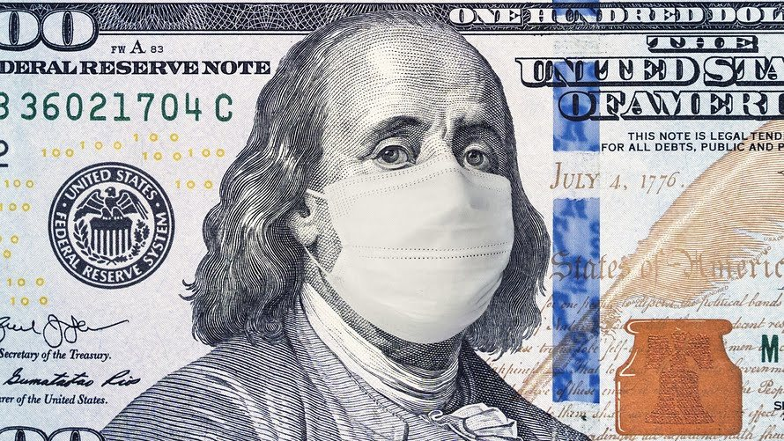
A. EXECUTIVE SUMMARY
“Strength Exists in Trusting That Rebirth Will Arrive Soon” – awritersbusiness.com

Slide 4
EXECUTIVE SUMMARY (Cont’d)…
Most respondents have a pandemic preparedness and response plan component in the business continuity plan (BCP).
Firms made tactical adjustments to their preparedness before invoking their BCPs, mobilizing staff.
They invoked their BCP by mid-March 2020, after the CDC initiated criteria for confirming cases and POTUS declared it a national emergency.
Firms then distanced their staffs, split critical functions and commenced work from home (WFH).
Most respondents were well-prepared, given the advanced warnings and extensive media coverage.

Slide 5
EXECUTIVE SUMMARY (Cont’d) …
Firms regularly communicated with staff and clients via email, direct phone call, and web site postings; conducted regular and ad-hoc conference calls and video sessions.
To support a large remote workforce, some firms upgraded their VPN, Cisco, Citrix and/or remote desktop infrastructures and remote access capabilities.
Regular and recent BCP awareness training, remote connectivity, systems testing and staff training exercises paid off.
Communication with key staff, decision makers was critical to the incident management process
Those that planned well, generally fared well.

Slide 6
EXECUTIVE SUMMARY (Cont’d) …
Many firms indicated that they had staff that were directly or indirectly affected by C-19 and could not perform their work function.
Respondents represented a cross section of U.S. financial services organizations.
The biggest problems were caused by supply chain disruptions, including:
  Network bandwidth or degradation of services when working at home
  Key service provider disruptions (internet providers, telecoms, market data)
  Systems processing and data storage capacity constraints as a result of excessive message rates and higher message traffic.

Slide 7
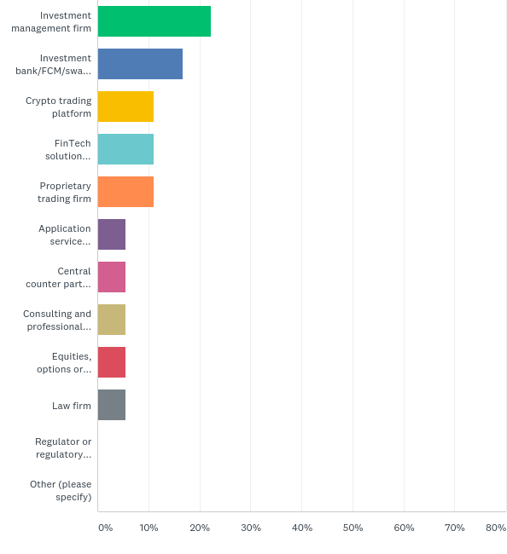
RESPONDENTS REPRESENTED A CROSS SECTION OF FINANCIAL SERVICES
Indicate the type of organization you work for:
Application service provider
Central counter party
Consulting services
Crypto trading platform
Equities/options/futures exchange
FinTech solution provider
Investment bank/FCM/swap dealer
Investment management firm
Law firm
Proprietary trading firm

Slide 8
B. INDUSTRY IMPACT
Most firms were able to quickly pivot, mobilize their staff and initiate WFH.
Firms supported the increased levels of high volume transactions, as a result of the market volatility.
Despite some network bandwidth challenges, firms’ staff, clients and service providers responded well to working remotely from home.
The levels of support from key service providers was rated highly.

Slide 9
INDUSTRY IMPACT (Cont’d) …
Some firms quickly configured VPN tunnels and deployed robust workstations or laptops to key staff that required them.
However, ~33% of firms experienced some forms of business disruption after invoking their BCP and distancing the staff.
Firms did not plan for the impacts from such a widespread, catastrophic event and the resultant emergency orders and workforce reductions.
They did not anticipate that multiple things could all go wrong at the same time. Most BCP strategies usually do not!

Slide 10
C. SURVEY FINDINGS
Preparedness and Business Continuance 11
Business and Supply Chain Disruptions 23
Response 28
Disaster Recovery and Risk Mitigation 33

Slide 11

I. PREPAREDNESS AND
BUSINESS CONTINUANCE

Slide 12
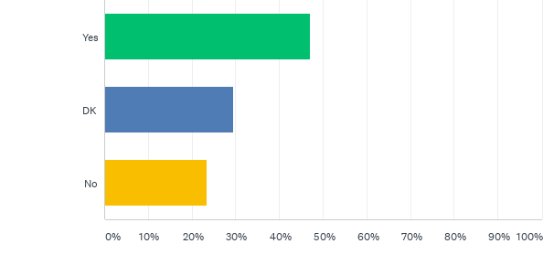
MOST FIRMS HAVE A PANDEMIC PREPAREDNESS COMPONENT TO THEIR BCP
Does your firm’s business continuity plan (BCP) have a pandemic preparedness and response plan component?

Slide 13
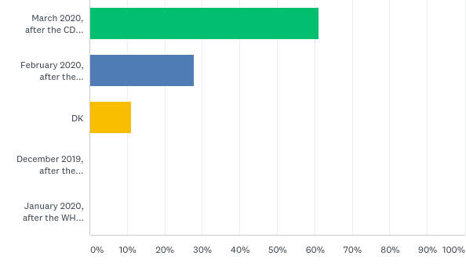
FIRMS INVOKED THEIR BCP AFTER THE CDC INITIATED CRITERIA FOR CONFIRMING CASES
AND A NATIONAL EMERGENCY WAS DECLARED
Approximately when did your firm invoke or enact it’s pandemic BCP:
December 2019, after the initial Wuhan cases were confirmed
January 2020, after the WHO declared the Coronavirus a global emergency
February 2020, after the escalation of media coverage of the global spread of the infections and fatalities
March 2020, after the CDC initiated criteria for confirming cases and POTUS declared it a national emergency

Slide 14
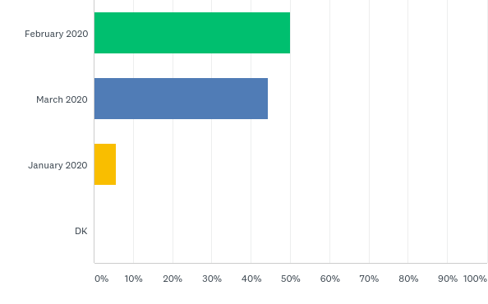
FIRMS COMMUNICATED WITH THEIR STAFF EARLY ON
When did your firm begin to communicate with its staff about a response plan?
January 2020
February 2020
March 2020

Slide 15
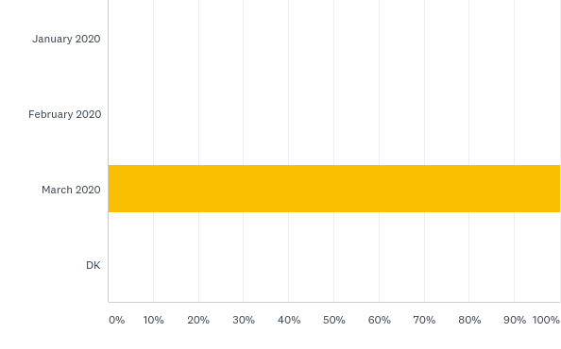
FIRMS DISTANCED THEIR STAFFS, SPLIT CRITICAL FUNCTIONS, COMMENCED WFH IN MARCH
When did your firm begin to socially distance the staff, either by splitting critical functions across offices/geographic sites and/or working from home/remote telecommuting?
January 2020
February 2020
March 2020

Slide 16
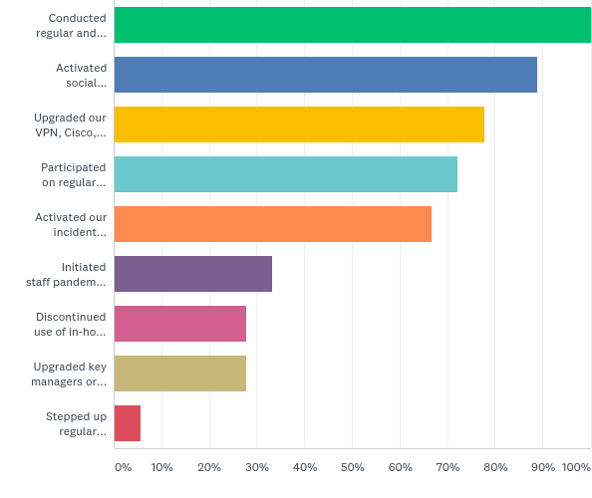
FIRMS EMPLOYED MULTIPLE PREPAREDNESS AND RESPONSE ACTIONS
Conducted regular and ad-hoc conference calls with staff, clients, counterparties, exchanges, service providers etc.
Activated social distancing via remote work sites/telecommuting
Upgraded our VPN, Cisco, Citrix and/or remote desktop infrastructures and remote access capabilities
Participated on regular conference call updates with state and local health agencies, industry associations
Activated our incident management team and created a virtual war room
Initiated staff pandemic awareness and personal hygiene training
Discontinued use of in-house fitness center and/or cafeteria/food service areas
Upgraded key sales/traders’ home computing set ups
Stepped up regular cleaning of office facilities, including desktops, conference and meeting rooms, bathrooms etc.

Slide 17
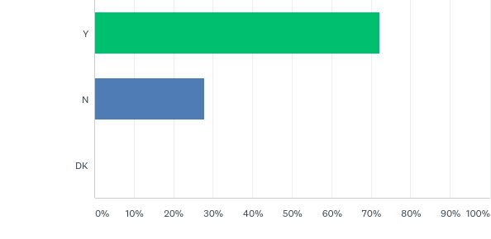
THE MAJORITY OF FIRMS HAVE ALTERNATE LOCATIONS TO CONTINUE CRITICAL BUSINESS OPERATIONS
Does your firm have an alternate office location(s) to distance the staff and continue to conduct business ?

Slide 18
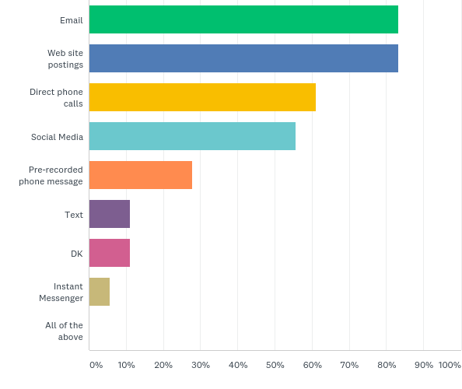
FIRMS REACHED OUT TO CLIENTS
VIA MULTIPLE MEANS
How did your firm reach out to its clients?
Email
Instant Messenger
Text
Social Media
Website postings
Pre-recorded phone messages
Direct phone calls

Slide 19
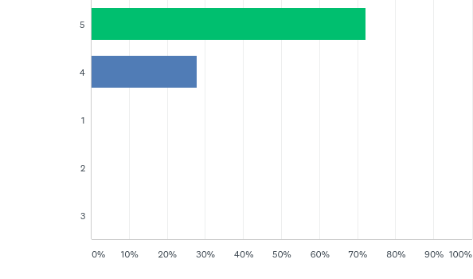
MOST FIRMS WERE WELL-PREPARED
TO RESPOND TO THE DISRUPTION
How would you rank your firm’s overall state of preparedness to respond to the disruption (Rank from 1-5 where 1= Not Well Prepared and 5=Very Prepared)?

Slide 20
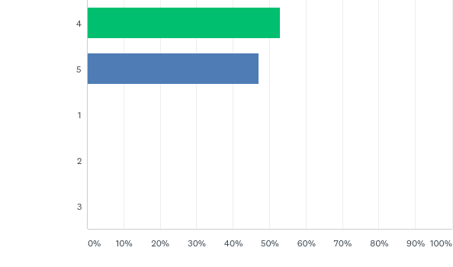
KEY SERVICE PROVIDERS WERE WELL-PREPARED TO SUPPORT FIRMS
How would you rank your firm’s overall state of preparedness from your key service providers (Rank from 1-5 where 1= Not Well Prepared and 5=Very Prepared)?

Slide 21

II. BUSINESS AND SUPPLY CHAIN DISRUPTIONS

Slide 22
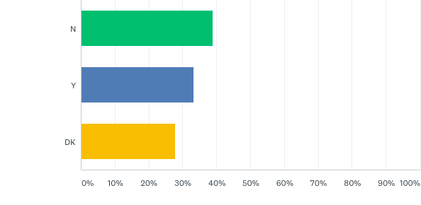
ONE-THIRD OF FIRMS EXPERIENCED
SOME FORM OF BUSINESS DISRUPTION
After enacting the BCP and distancing the staff, did your firm conduct business without disruption?

Slide 23
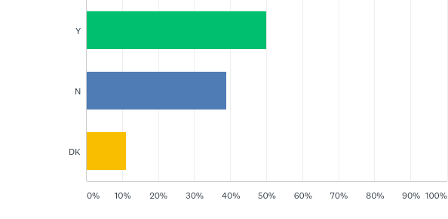
HALF OF FIRMS HAD STAFF THAT WERE DIRECTLY / INDIRECTLY AFFECTED, C-19 DISRUPTED THEIR WORK FUNCTION
Did you have staff that were directly or indirectly infected with COVID-19 (family members or significant others) that took them offline so they could not temporarily perform their work function?

Slide 24
Q: What types of disruptions did your firm encounter?
Network bandwidth/degradation of services when working at home
Key service providers (internet, telecoms, market data, EMS, etc.
Systems processing and data storage capacity constraints as a result of the excessive trading-related message rates (market data trades and quotes) and higher message traffic
Essential staff that were required to report to the office had difficulty with access/were challenged by local police for travel authorization letters
Public transportation disruptions (trains, subway, buses)
Lack of liquidity providers at markets and exchanges
If the office remained open, we had disruptions with availability of janitorial staff to clean the facilities on a regular basis, trash collection/recycling and disposal or mail/express mail
Challenges with food suppliers and takeout food delivery
Outsourced service providers were impacted by local area telecom disruptions or degradation of services
Order flow providers

Slide 25
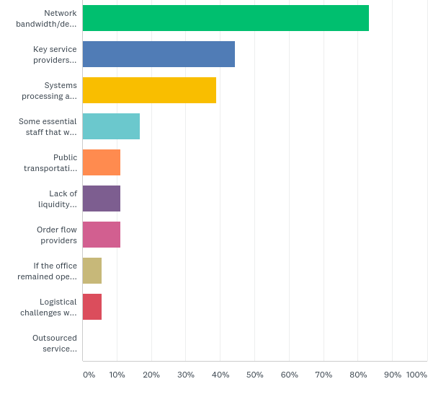
FIRMS EXPERIENCED VARYING TYPES OF
C-19 RELATED DISRUPTIONS TO THEIR BUSINESS

Slide 26
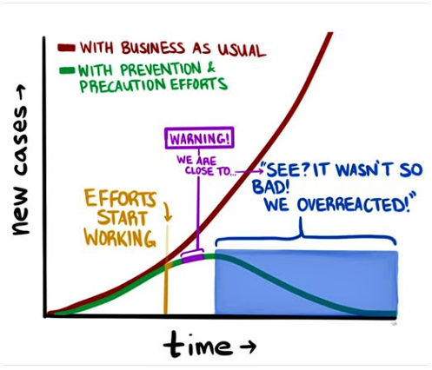
III. RESPONSE

Slide 27
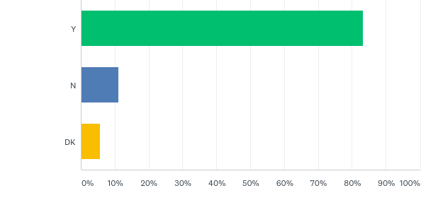
THE MAJORITY OF FIRMS HAVE AN EMERGENCY NOTIFICATION SYSTEM OR CALL TREE
Does your firm have an emergency notification system or call tree system?

Slide 28
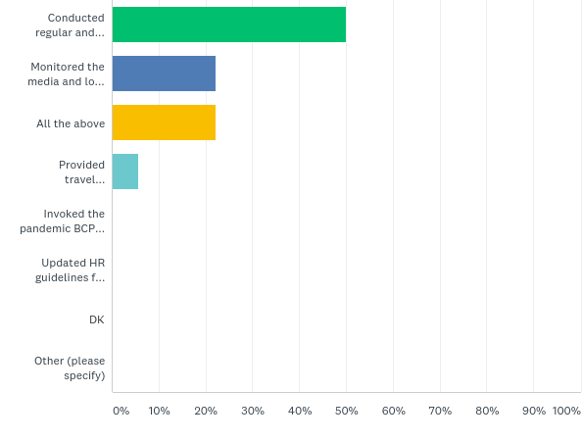
INCIDENT MANAGEMENT TEAMS AND
KEY MANAGERS RESPONDED WELL
How did your key managers and incident management team respond to the emergency?
Conducted regular and ad-hoc conference calls to collaborate on the response
Monitored the media and local conditions, making some tactical adjustments as the situation unfolded
Provided travel authorization letters for key staff in critical support functions who were required to report to the office.

Slide 29
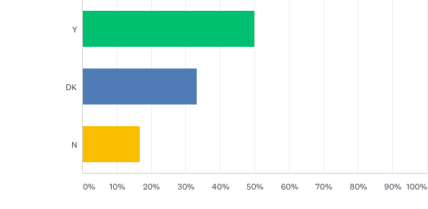
HALF OF FIRMS CORDINATED THEIR RESPONSE WITH STATE / LOCAL HEALTH AGENCIES, REGULATORS AND BUILDING MANAGEMENT
Did your firm coordinate its response with state or local health agencies, regulators and the building management company etc.?

Slide 30
THE MAJORITY OF FIRMS HAVE DESIGNATED EMERGENCY RESPONSE TEAMS
Does your firm have designated emergency response teams?

Slide 31
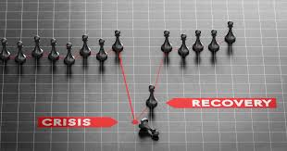
IV. DISASTER RECOVERY AND RISK MITIGATION

Slide 32
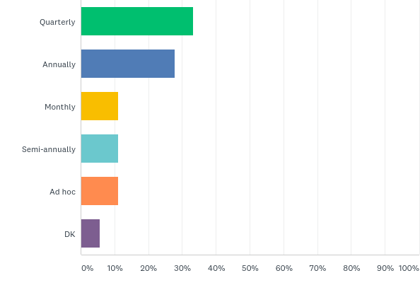
MOST FIRMS CONDUCT REGULAR BC/DR TESTING
How often does your firm conduct BC/DR testing ?
Monthly
Quarterly
Semi-annually
Annually

Slide 33
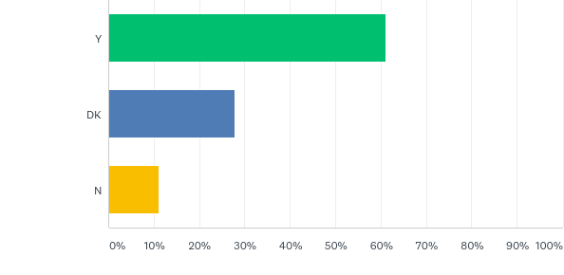
FIRMS CONDUCT REGULAR BC/DR TESTING
FOR ALL THEIR LOCATIONS
Has your firm conducted staff BC/DR training drills for all locations?

Slide 34
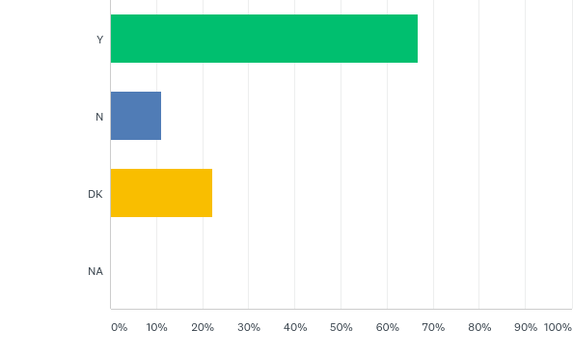
… AND CONDUCT REMOTE WORKFORCE
AND CONNECTIVITY TESTING
Has your firm previously conducted remote workforce connectivity, access and telecommuting for all locations?

Slide 35

D. LESSONS LEARNED

Slide 36
GIVEN THE LEAD TIME, MOST
FIRMS WERE VERY PREPARED
Unlike sudden-onset disasters, the global spread of the pandemic dominated the news for weeks prior to major impacts in the U.S.
How do you rate your firm’s preparedness and actions, given the lead time?
Based on the lead time for warnings please rank from 1-5 where 1= Not Well Prepared and 5= Very Prepared.

Slide 37
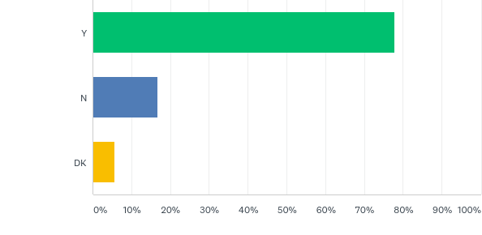
MANY FIRMS MADE ADJUSTMENTS TO THEIR PREPAREDNESS BEFORE INVOKING
THEIR BCP, MOBILIZING STAFF
Did your firm make any adjustments to its BCP preparedness and responses between the time that the WHO declared it a global emergency (Jan 30) the time your plan was invoked and staff mobilized?

Slide 38
Q: In retrospect, what worked well for your firm
We made tactical adjustments to our plan, as the virus situation and market conditions changed
We frequently and regularly communicated with our remote workforce to discuss the state of the business and to assess their wellbeing
Our infrastructure held up as expected
Regular communications with staff, clients and counterparties was very effective
We had staff that self-quarantined, out of an abundance of caution
We quickly configured VPN tunnels and deployed robust workstations to trading staff homes that required them
We planned for the worst case; the staff was prepared and responded well under the circumstances; testing of staff, infrastructure and systems paid off
Remote access and telecommuting worked well
We had a process for capturing and reporting staff health and wellness issues

Slide 39
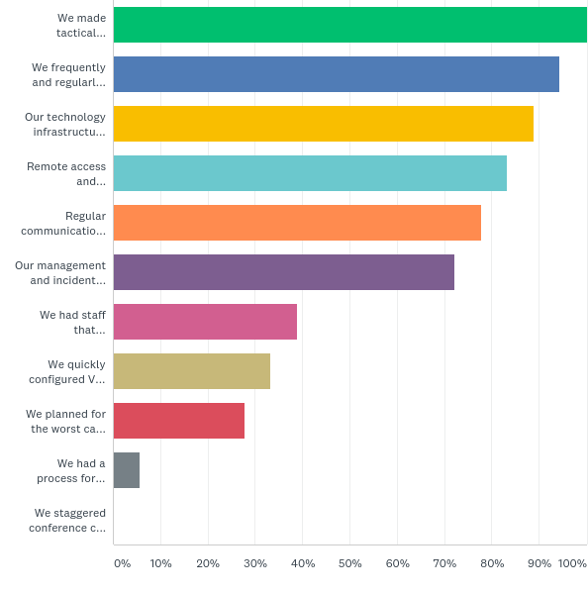
MANY THINGS WORKED REALLY WELL !

Slide 40
Q: What did not work well
We did not anticipate nor plan for such a widespread, catastrophic event and the dynamic impacts from accompanying emergency orders and resultant workforce reductions
We did not anticipate that multiple things could all go wrong at the same time
Our incident management/crisis management process did not function as we expected
Our staff was not properly prepared for the magnitude of the event
We had multiple staff that self-quarantined
We did not have a formal process to track staff health and wellness issues
Our remote teams did not function as smoothly as they could have
We encountered network bandwidth and degradation of service challenges for remote workforce
Our infrastructure could not keep up with the demands from remote users
Call forwarding of office phones was not as seamless as we expected
We underestimated the needs and scope of critical functions that could/could not be performed or supported remotely
We had an unusually large amount of calls from clients and could not serve them as promptly and efficiently as possible
Our help desk staff was severely challenged by the constant and heavy amount of problem calls
Key connectivity and access to large scale data sets from remote sites exceeded our software-based VPN capabilities
We were challenged in trying to procure, configure and deploy laptop computers and workstations to critical staff and sales/traders

Slide 41
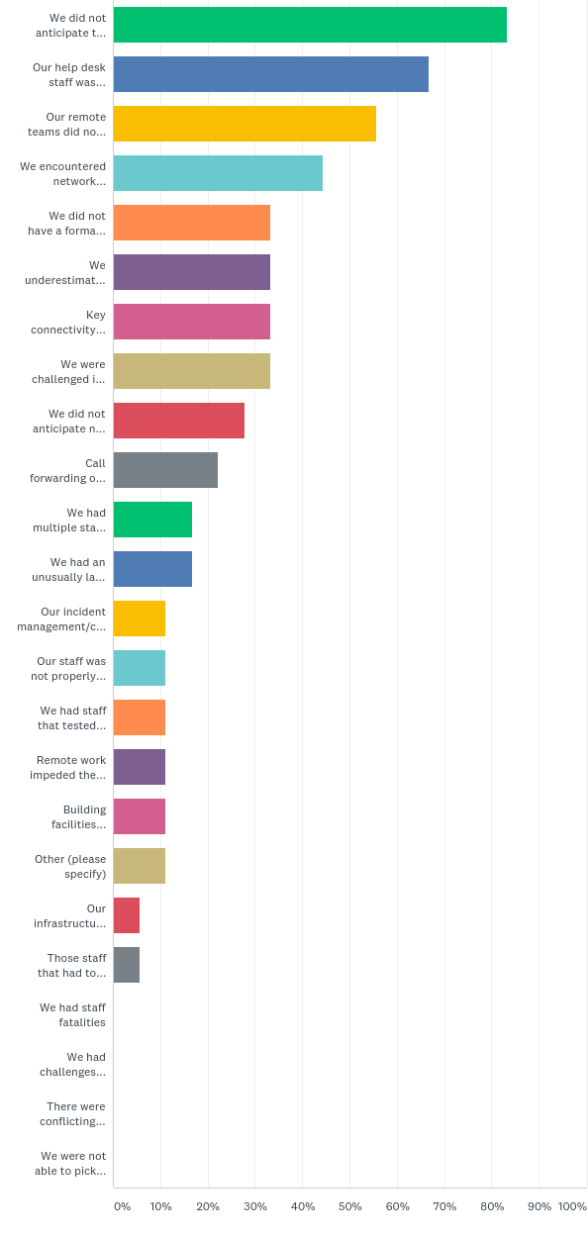
BUT A NUMBER OF THINGS DID NOT …

Slide 42
THE BIGGEST, MOST UNPLESANT SURPRISES .. …
The scope, magnitude and duration of the contagion.
The widespread scale of the disruption and the rate and
number of businesses that shut down so quickly.

Slide 43
THE BIGGEST MISSTEPS
IN PLANNING AND PREPARING …
Underestimating the speed and ferocity of the virus, and believing that this would pass.
“My internal post about the pandemic on Jan 31 was considered too scary and the escalation of this news was dismissed”.
“Not adding multiple displays to the contingency office site desktops. These and other new devices had been requested for over 2 years”.

Slide 44
Q: In what areas does your firm plan to make changes to going forward?
Develop a report of actions taken, lessons learned etc., and a plan to address/mitigate short-term and long-term issues, risks and recommendations
Reschedule or postpone events and meetings to later in the year/next year
Document the pros and cons of a remote work force under this adverse scenario
Review of all key facilities, services providers and infrastructures that support the business
Develop a plan to regularly test remote access infrastructures, collaboration tools and remote workforce capabilities
Update HR guidelines as they apply to managing a remote workforce of essential and non-essential personnel, needs for collaboration etc.
Review and update emergency communications tools and procedures, client communications plans
Identify the key connectivity and data needs for users of large data sets and complex data operations for those in revenue-generating functions
Increase spending on remote access infrastructure, collaboration tools and network capabilities, overall BC/DR planning and preparedness, checklists for the remote workforce
Increase staff training on BCP strategy and tactics
Evaluate our operational costs going forward, due to increased safety measures and social distancing guidelines.

Slide 45
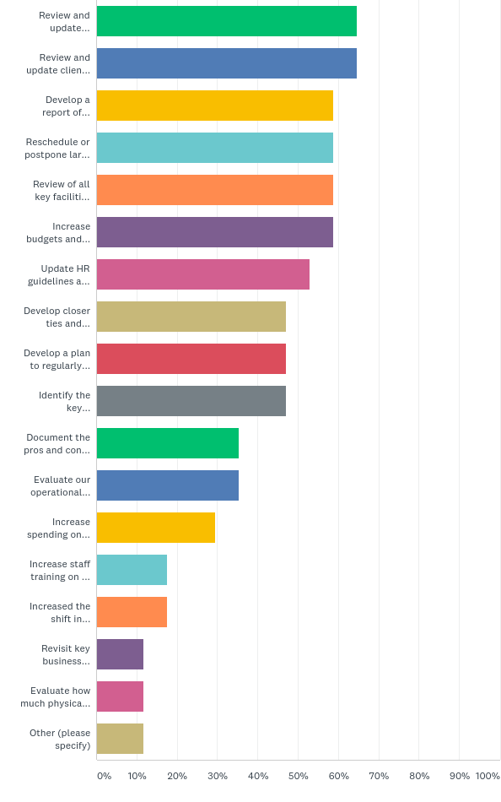
FIRMS PLAN NUMEROUS CHANGES,
GOING FORWARD

Slide 46

E. CONCLUSIONS

Slide 47
CONCLUSIONS (Cont’d) …
Even the most thoughtful, best tested plans do not contemplate multiple events all going wrong at the same time.
Most firms have implemented a resilient technology infrastructure and a mature business continuance structure and business continuity awareness.
Firms were well-prepared, given the advanced warnings and media coverage.
Firms need to better encourage the personal preparedness of their staff.
Those that planned well, generally fared well.

Slide 48
F. SUGGESTED NEXT STEPS
Develop a report of actions taken, lessons learned and a plan of action to address/mitigate any deficiencies or risks.
Evaluate the pro’s and con’s of a remote workforce under such an adverse scenario.
Analyze and provide additional hardening of key staff home computing set ups.
Budget for increased spending on technology infrastructure required to support a large remote workforce and new social distancing guidelines.

Slide 49
SUGGESTED NEXT STEPS (Cont’d) …
Conduct post-mortem evaluations to learn from the experience – what worked well, what didn’t:
  The state of staff’s home computing set ups, remote collaboration experiences
  Identify gaps, update plans, processes and technology accordingly
Post-mortem reviews should consider:
  Potential vulnerabilities of key service providers, especially ASP and cloud service providers
Closely monitor conditions in your city/state.
Don't hesitate to take a "step back" if the pandemic starts a new surge (retreat, regroup and be prepared to fight again).

Slide 50

Be Prepared for The Unexpected Things
That Can Jump Out and Sucker Punch You…

Slide 51

Tellefsen and Company, L.LC.
Business Continuity and Advisory Services
1-212 809 3800
info@tellefsen.com
John Rapa Craig Conti
Industry Impact and Lessons Learned From the COVID-19 Pandemic

