Slide 1
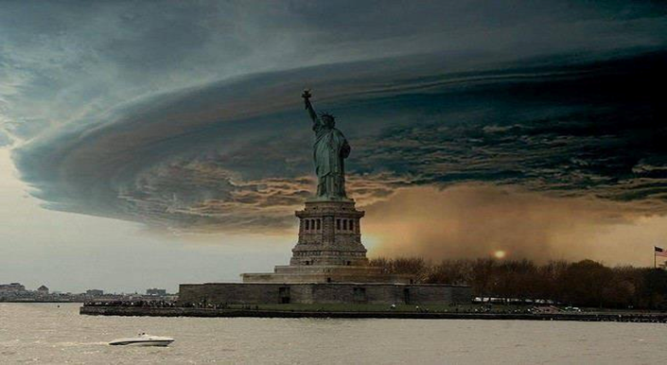
INVESTMENT MANAGEMENT SURVEY:
INDUSTRY IMPACT AND LESSONS LEARNED
FROM HURRICANE SANDY
January 9, 2013

Slide 2
TABLE OF CONTENTS
Page Number
Background 3
Executive Summary 7
Industry Impact 10
Survey Findings 17
Lessons Learned 48
Anecdotal Feedback 54
Conclusions 57
Discussion, Next Steps 61

Slide 3
A. BACKGROUND
The Northeast U.S. was devastated by Hurricane Sandy on October 28-30 2012, but unlike prior hurricanes and Nor'easters, there was a lead time for those in harm’s way to prepare, prior to Sandy making landfall on October 30th
The National Weather Service, National Oceanographic and Atmospheric Administration and NASA all tracked the storm via numerous weather models
Tellefsen and Company, L.L.C. (TCL) developed a comprehensive survey of leading investment management firms, relative to key Business Continuity Management (“BCM”) strategies and tactics.

Slide 4
BACKGROUND (Cont’d) …
Firms were surveyed on the impact to their businesses and lessons learned from Hurricane Sandy, and provided feedback on the state of their preparedness and experience
Survey responses were collected and aggregated without attribution to any individual or firm, and some respondents did not answer every question
The survey encompassed feedback on key BCM metrics:
Business Continuity Preparedness
Disaster Recovery
Supply Chain Disruptions
Response
Recovery
Risk Mitigation

Slide 5
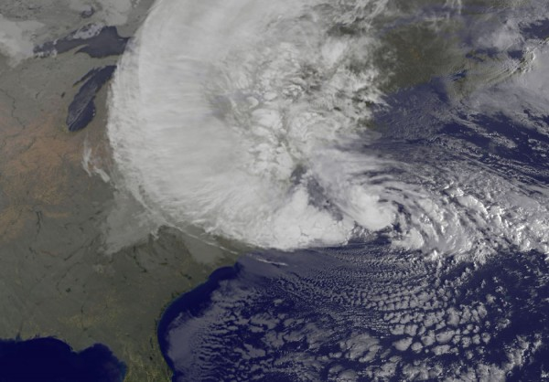
B. EXECUTIVE SUMMARY
Sandy - A Storm of Biblical Proportions …

Slide 6
EXECUTIVE SUMMARY (Cont’d)…
Firms were well-prepared, given the advanced warnings and extensive media coverage
Firms activated their BCP coming into the weekend and few had to failover to DR
Those that planned well generally fared well
Communication with key staff, decision makers was critical to the incident management process
Firms regularly communicated status to staff, clients via email, direct phone call, web site postings.

Slide 7
EXECUTIVE SUMMARY (Cont’d) …
Metro NYC public transportation was closed, including bridges and tunnels
Most staff could work remote via terminal server or Citrix server connectivity, however, those that lost power and services were unable to telecommute or collaborate
The storm caused the closure of U.S. equity markets, which impacted operations such as valuations, access to cash and settlements
Employees were unable to leave home due to storm damage, lack of transportation or unwilling to leave their families
Regular and recent BCP awareness training, systems testing and staff training exercises paid off.

Slide 8
EXECUTIVE SUMMARY (Cont’d) …
The power grid in lower Manhattan was adversely impacted by the tidal surge, and was ultimately shut down to prevent further damage, facilitate re-start
Firms may re-consider the proximity and locations of their primary and back up facilities, going forward
The biggest problems were caused by supply chain disruptions:
Closure of public transportation
Closure/inaccessibility of key roads
Outages with power and telecomm providers
Staff inability to commute into metro NYC due to downed trees, power lines and local street closures

Slide 9
C. INDUSTRY IMPACT
Hurricane Sandy made landfall in New Jersey on Sunday evening October 30
Sandy brought with it heavy winds, rain, flooding and caused widespread power outages
Sandy impacted an area populated by over 50 million people, a greater impact than Hurricane Katrina
The heavy winds extended over 500 miles from the eye of the storm
In Chicago on Tuesday, 22’ waves pounded the lakefront
New York City closed public transportation, bridges and tunnels on Sunday evening.

Slide 10
INDUSTRY IMPACT (Cont’d) …
Power to lower Manhattan was cut by Con Edison on Monday to protect electrical equipment, as the storm surge threatened underground electrical equipment, including transformers and sub-systems
Due to the closure of public transit and road closures from downed power lines and trees, employees were unable – or unwilling - to commute
Firms with international offices heavily relied on those offices for operational support and transferred functions to them
A tower crane collapse in mid-town, cordoned off a 4 square block area and caused closures and building evacuations.

Slide 11
INDUSTRY IMPACT (Cont’d) …
U.S. equity and equity options markets were closed on Monday and Tuesday:
U.S. futures markets opened on Monday, except for equity based futures products
Overseas markets were tempered by the closure of the U.S. markets
From an operational perspective, valuations, access to cash, money markets, month-end processing and settlements were impacted by the market closings, as well as companies’ reporting of earnings
Some firms had limited operations and IT capabilities, as a result of their failover to DR mode
Others experienced loss of key service providers, and/or counterparties.

Slide 12
THERE WAS LEAD TIME PRIOR TO SANDY MAKING LANDFALL
NASA, NOAA and major weather services tracked the genesis of Sandy as a tropical storm in the Caribbean starting on the prior Monday (10/22)
They utilized a number of weather models showing likely trajectories and impact areas
Sandy slammed into Jamaica and Haiti on Wednesday 10/24 as a Category I hurricane with 80-90 MPH winds
It then hit Cuba, the Dominican Republic and the Bahamas on Thursday 10/25 as a Category 2 storm
Sandy progressed on a NNE track into Sunday 10/28 and made landfall around Atlantic City NJ on Monday 10/29 as a Category I storm with 80-90 MPH winds.
Source: LiveScience.com

Slide 13
HURRICANE SANDY: PATH AND TIMELINE

Slide 14
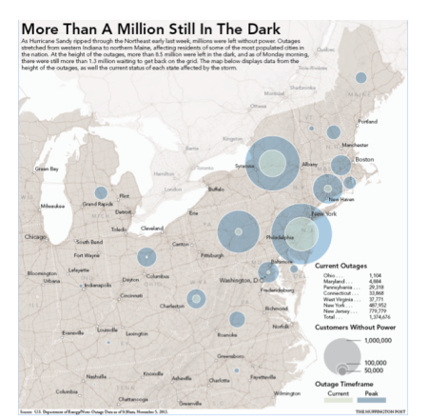
ONE WEEK LATER: EXTENSIVE POWER OUTAGES

Slide 15
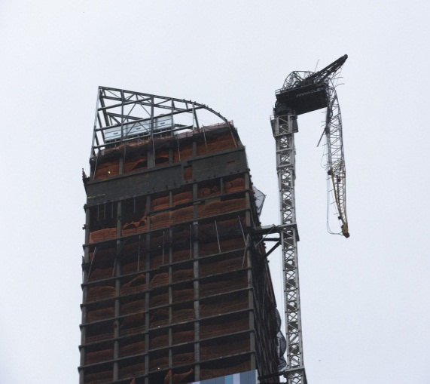
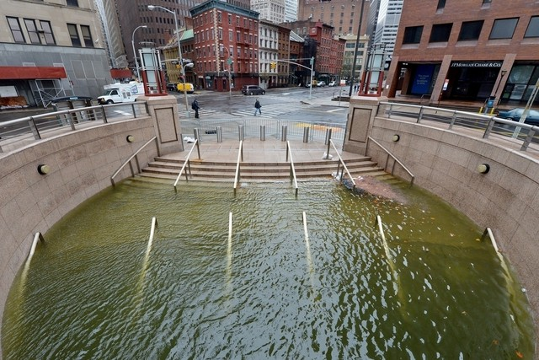
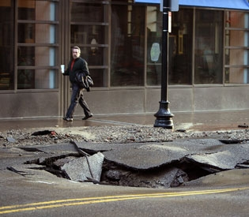
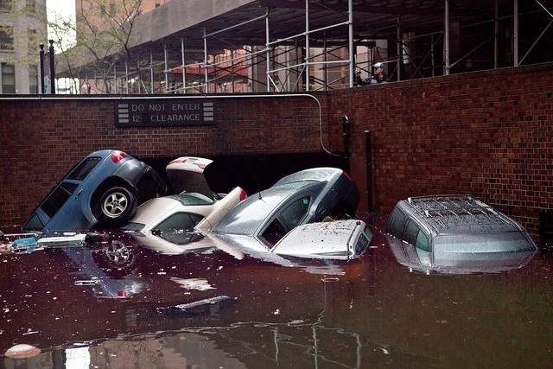
SOME OF THE DEVASTATION …

Slide 16
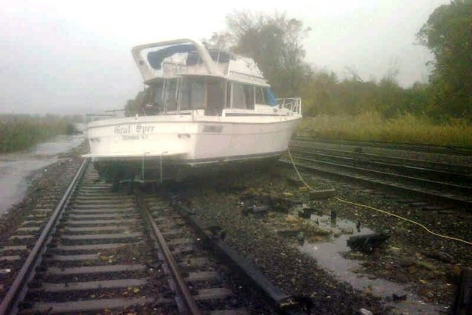
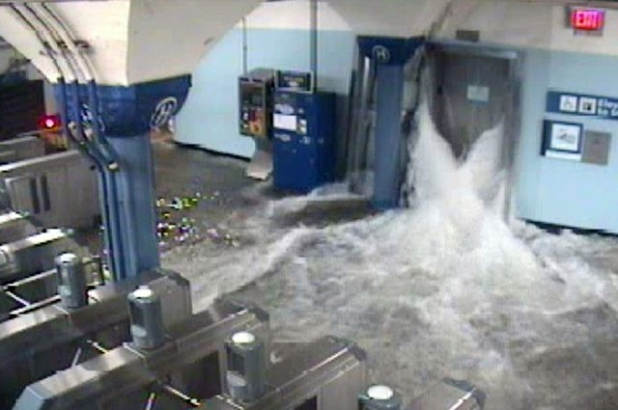
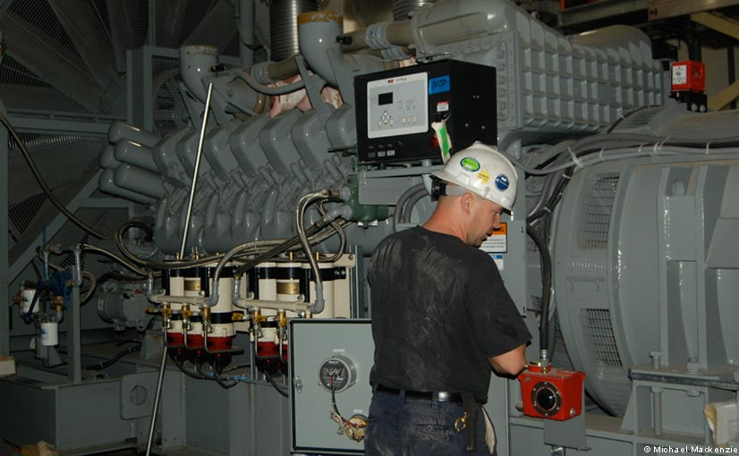
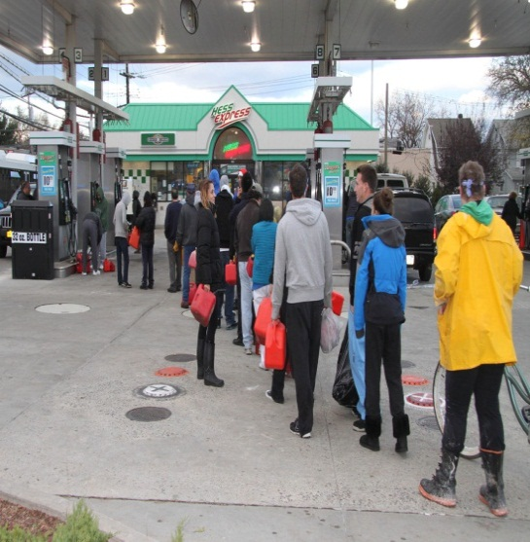
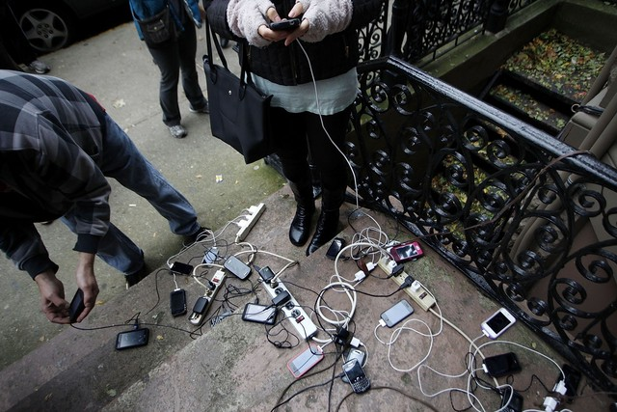
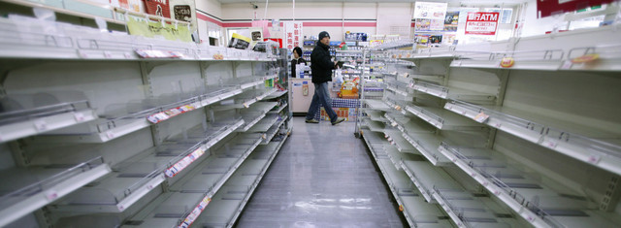
AND SUPPLY CHAIN DISRUPTIONS…

Slide 17
D. SURVEY FINDINGS
Business Continuity Preparedness
Disaster Recovery
Supply Chain Disruptions
Response
Recovery
Risk Mitigation

Slide 18
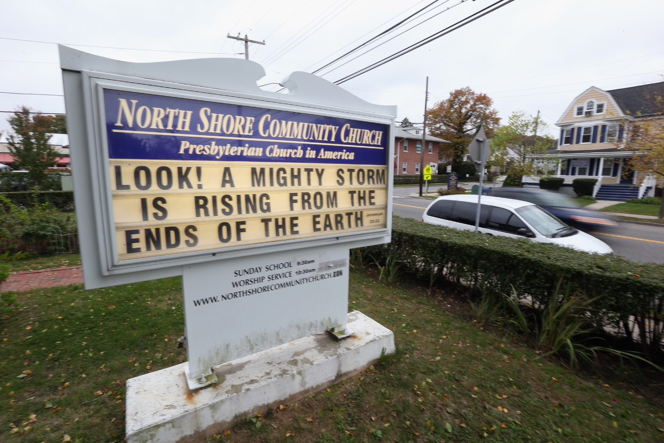
I. BUSINESS CONTINUITY PREPAREDNESS

Slide 19
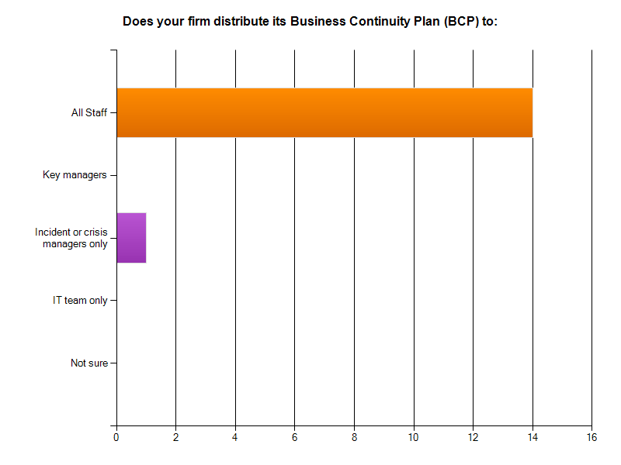
STAFF HAVE ACCESS TO BUSINESS CONTINUITY PLANS AND STRATEGY

Slide 20
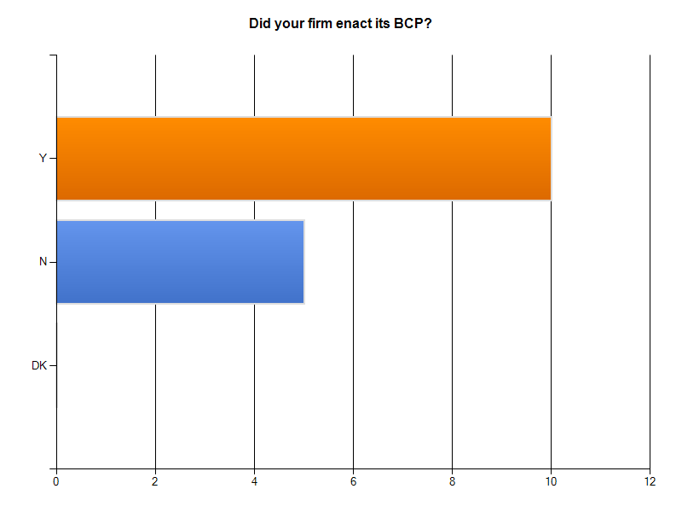
TWO-THIRDS OF FIRMS ACTIVATED THEIR PLANS INTO THE WEEKEND

Slide 21
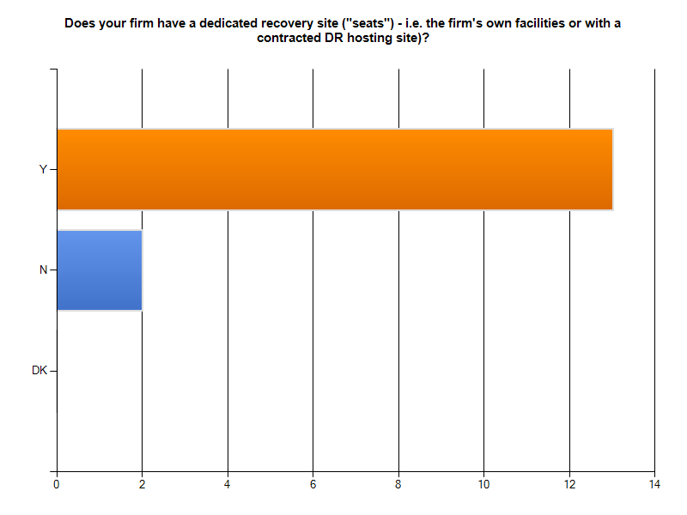
THE MAJORITY OF FIRMS HAVE DEDICATED SITES FOR RECOVERY

Slide 22
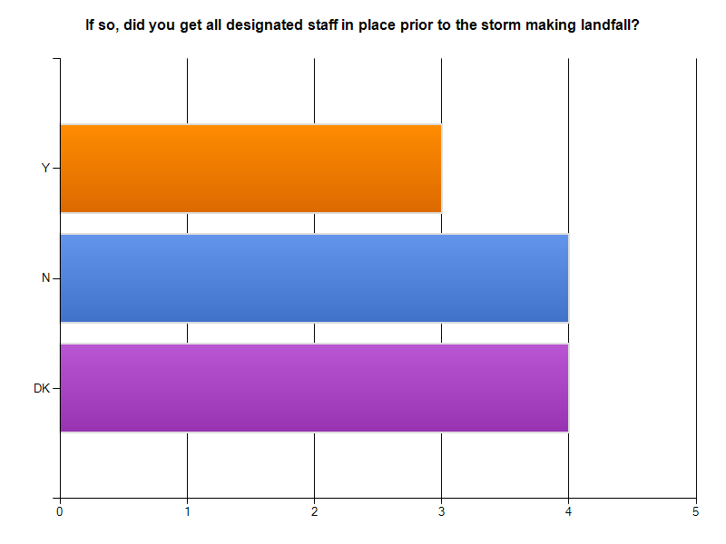
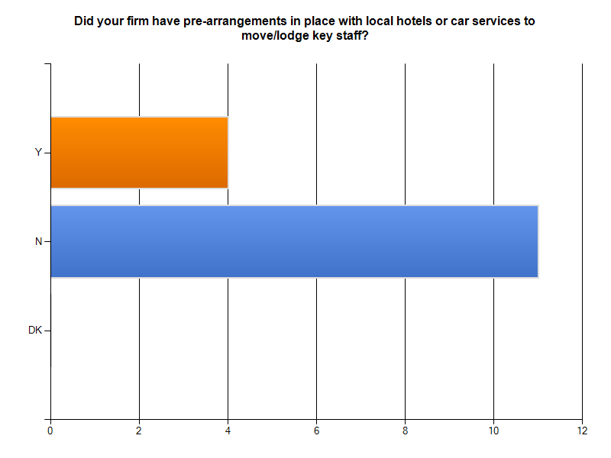
FIRMS DID NOT RE-LOCATE STAFF, DID NOT PRE-ARRANGE HOTELS

Slide 23
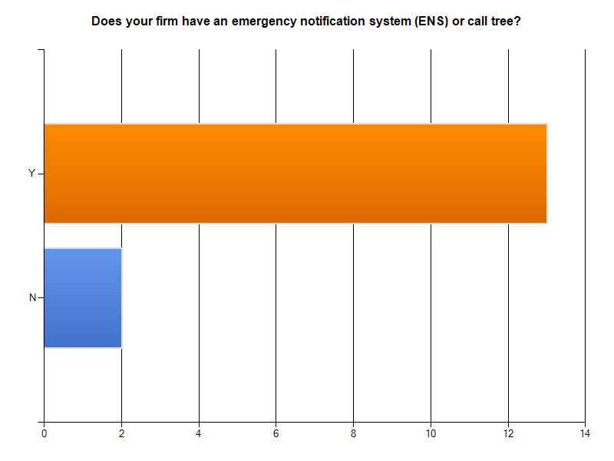
THE MAJORITY OF FIRMS HAVE AN EMPLOYEE NOTIFICATION SYSTEM

Slide 24
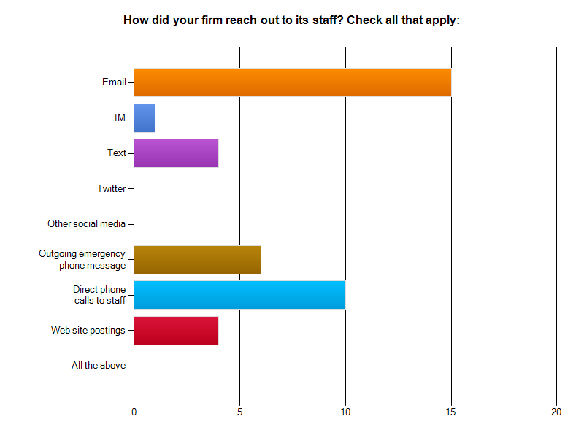
FIRMS COMMUNICATED WITH STAFF VIA MULTIPLE MEANS

Slide 25
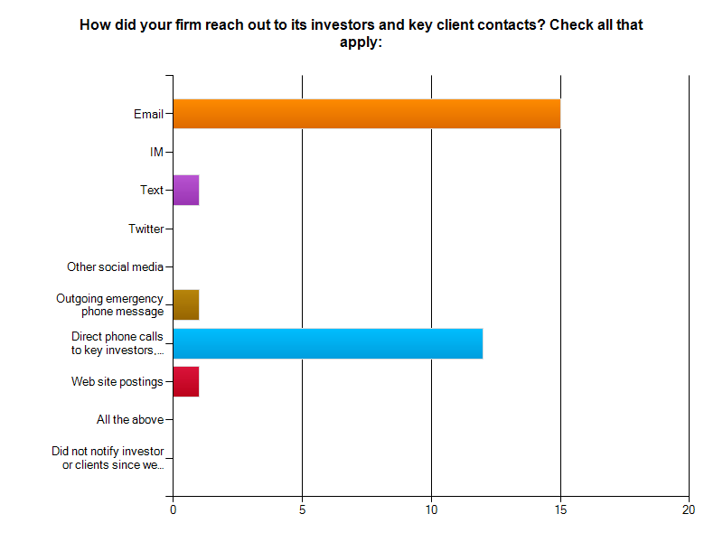
INVESTORS AND KEY CLIENTS WERE CONTACTED VIA EMAIL, PHONE

Slide 26
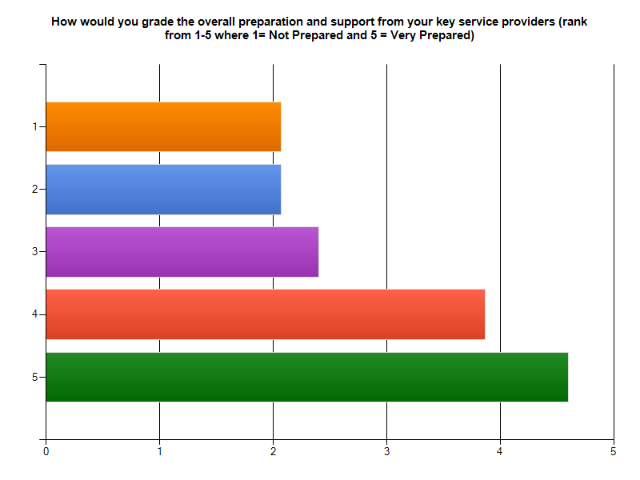
KEY SERVICE PROVIDERS’ PREPARATION AND SUPPORT WAS HIGHLY RANKED

Slide 27
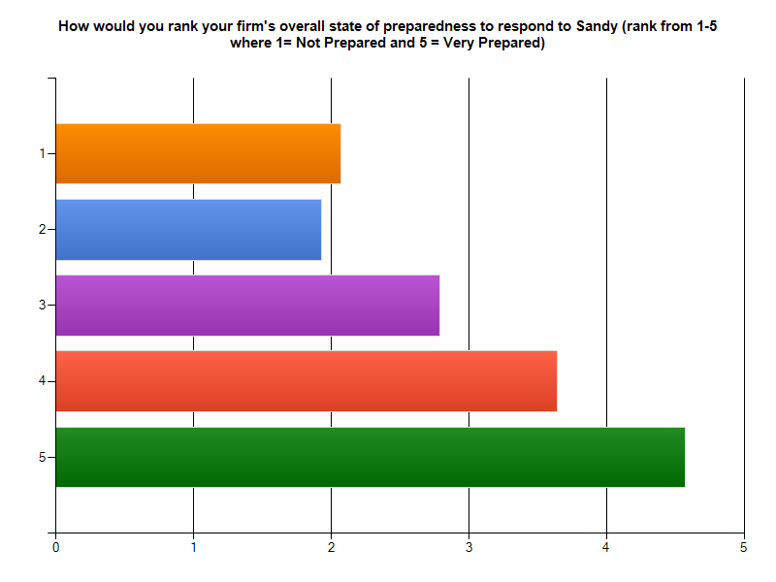
THE MAJORITY OF FIRMS CONSIDERED THEMSELVES WELL-PREPARED

Slide 28
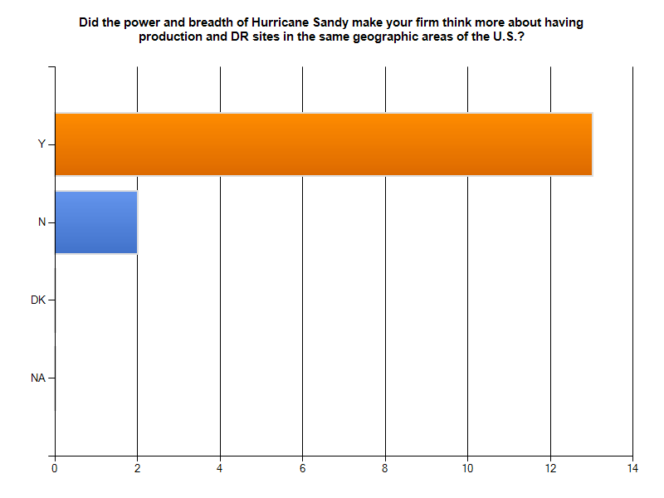
FIRMS MAY RE-CONSIDER THE PROXIMITY, LOCATIONS OF PRODUCTION, DR SITES

Slide 29
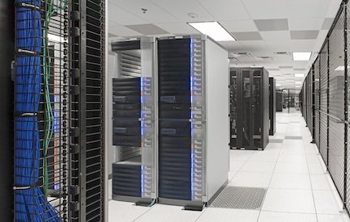
II. DISASTER RECOVERY

Slide 30
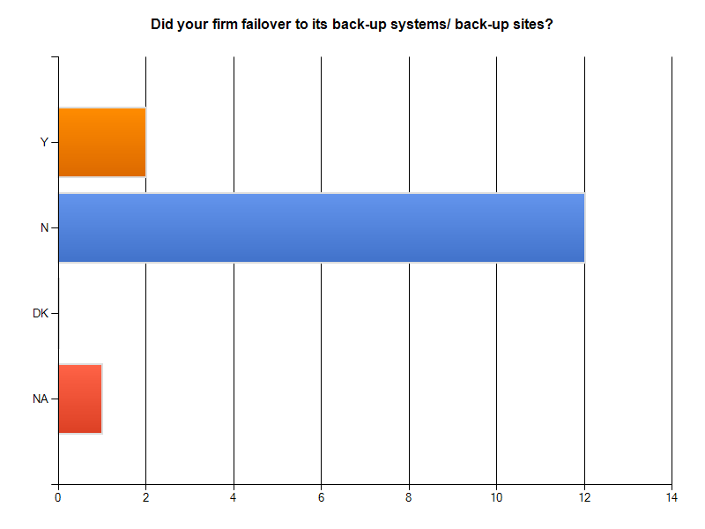
MOST FIRMS DID NOT FAIL OVER TO DR; OTHERS DID SO BY SUNDAY PM

Slide 31
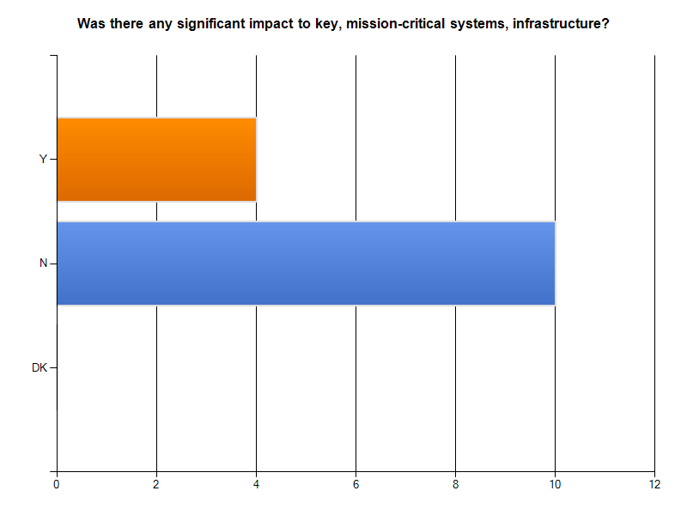
THERE WAS NO SIGNIFICANT IMPACT TO FIRMS’ MISSION-CRITICAL SYSTEMS, INFRASTRUCTURE

Slide 32
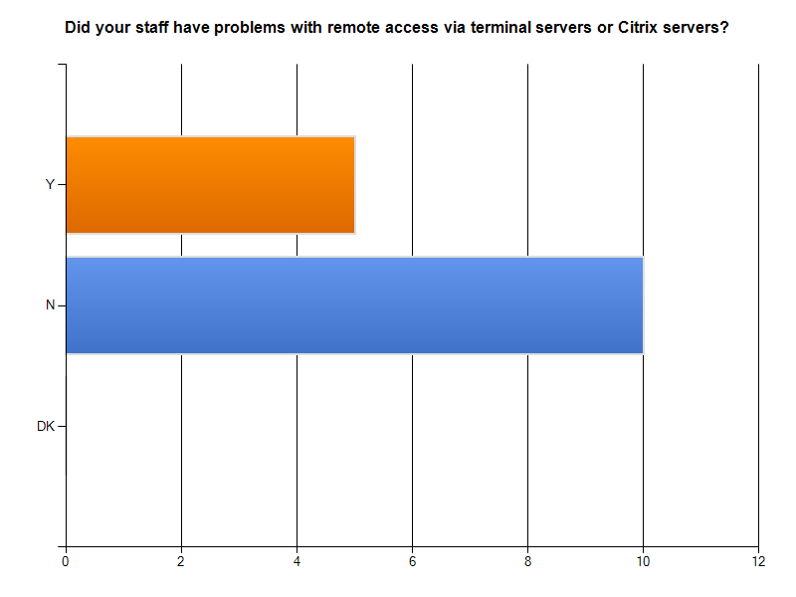
MOST STAFF COULD TELECOMMUTE VIA TERMINAL SERVERS OR CITRIX SERVERS

Slide 33
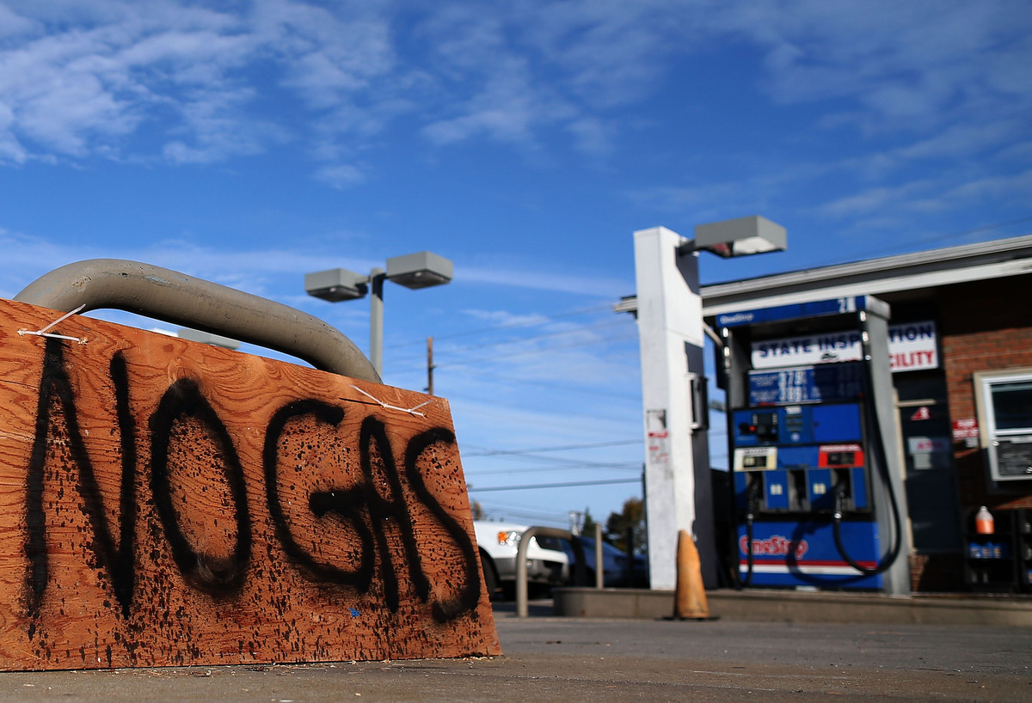
III. SUPPLY CHAIN DISRUPTIONS

Slide 34
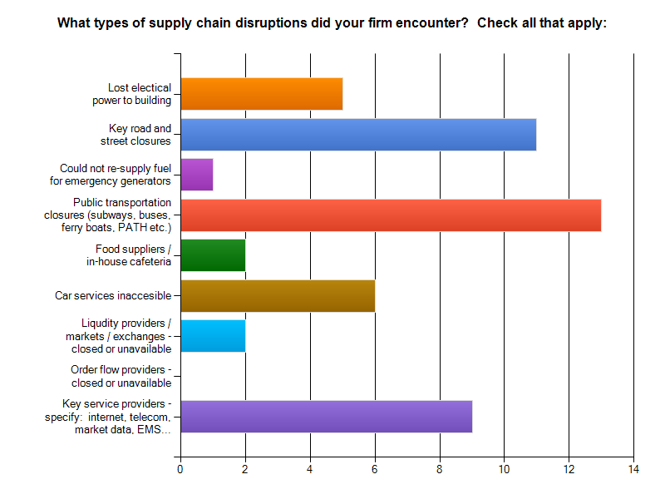
THE BIGGEST DISRUPTIONS: PUBLIC TRANSPORTATION, ROAD CLOSURES, KEY SERVICE PROVIDERS

Slide 35
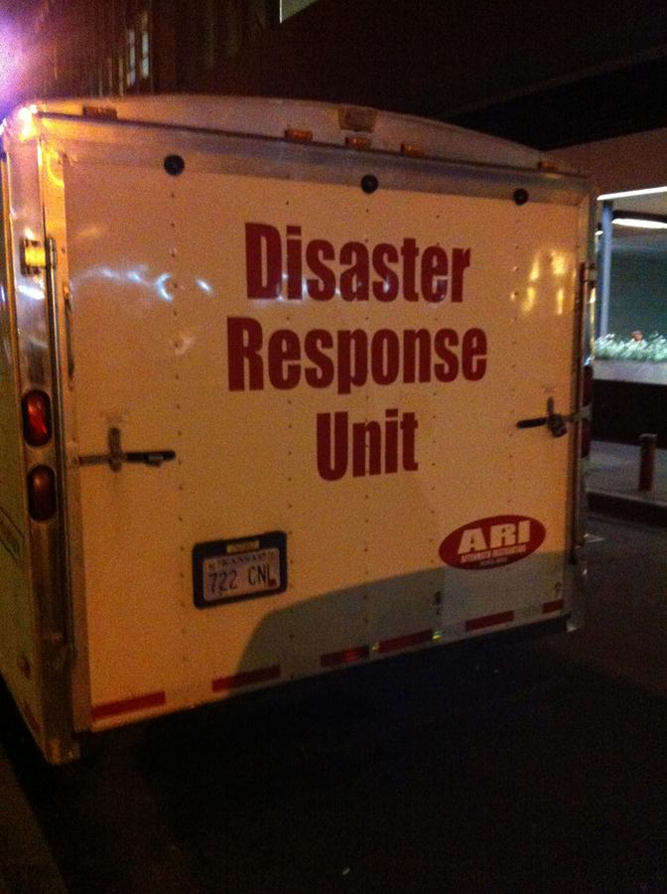
IV. RESPONSE

Slide 36
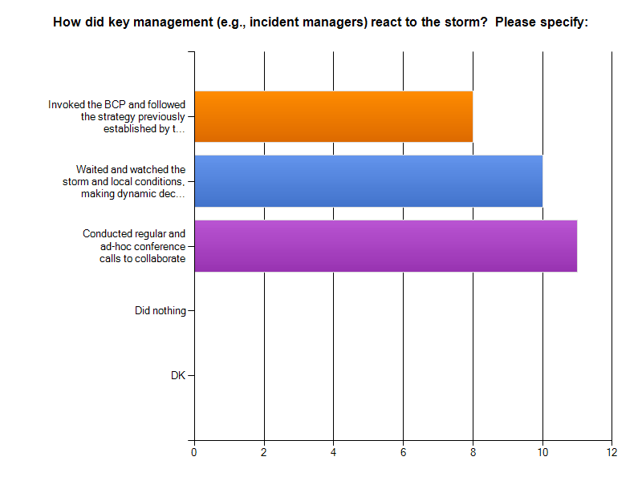
INCIDENT MANAGERS WERE ACTIVATED, COMMUNICATED, AND EXECUTED THE PLAN

Slide 37
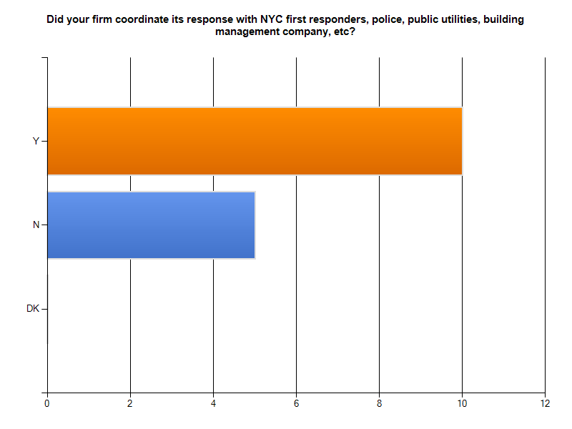
FIRMS COORDINATED THEIR RESPONSES WITH KEY SERVICE/SUPPORT PLAYERS

Slide 38
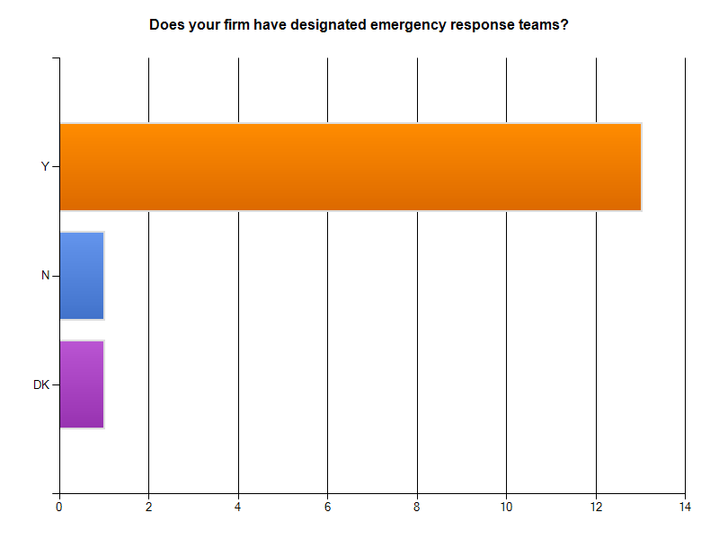
MOST FIRMS HAVE DESIGNATED RESPONSE TEAMS

Slide 39
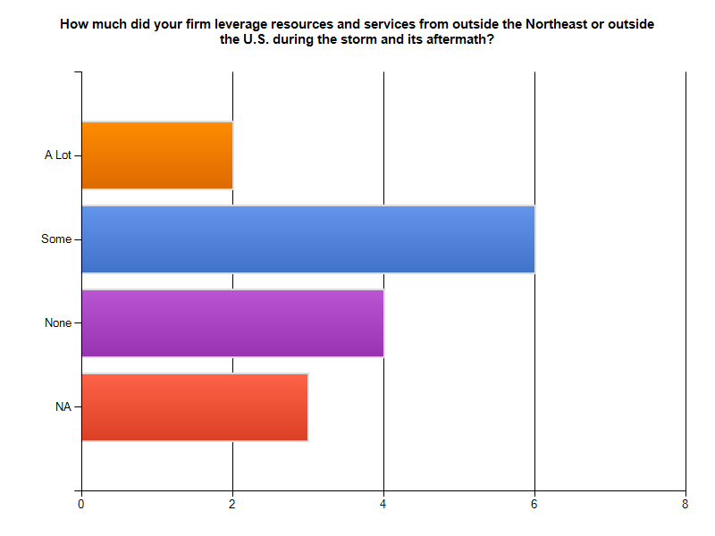
FOLLOWING THE STORM, FIRMS LEVERAGED GLOBAL SUPPORT TEAMS

Slide 40
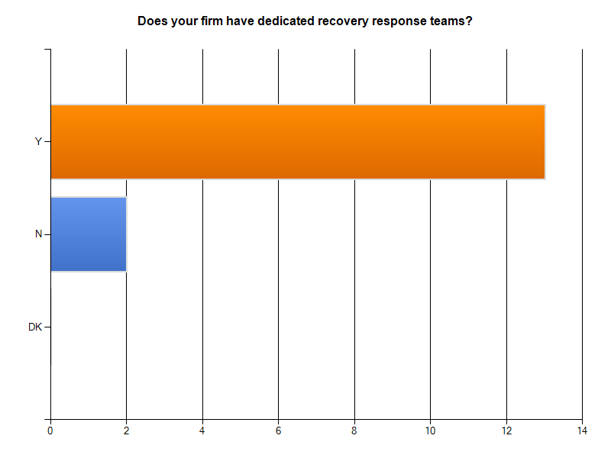
ALMOST ALL FIRMS HAVE DEDICATED RESPONSE TEAMS

Slide 41
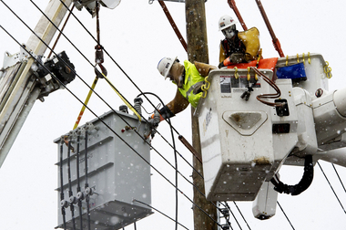
V. RECOVERY

Slide 42
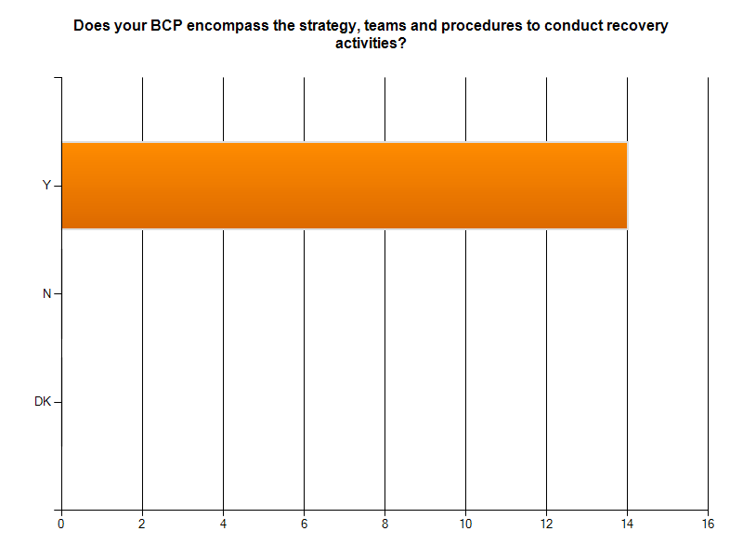
FIRMS WERE WELL-PREPARED FOR RECOVERY ACTIVITIES

Slide 43
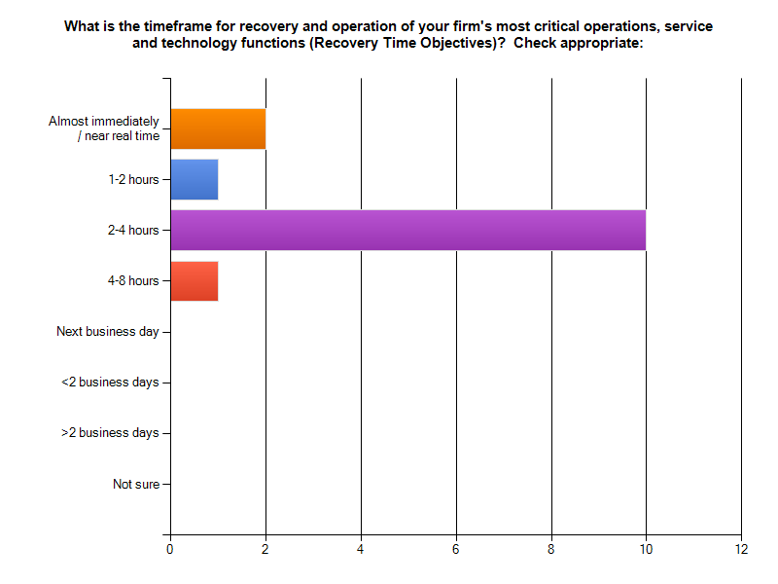
MOST MISSION-CRITICAL FUNCTIONS CAN BE RECOVERED WITHIN 4 HOURS, MANY IMMEDIATELY OR WITHIN 2 HOURS

Slide 44
VI. RISK MITIGATION

Slide 45
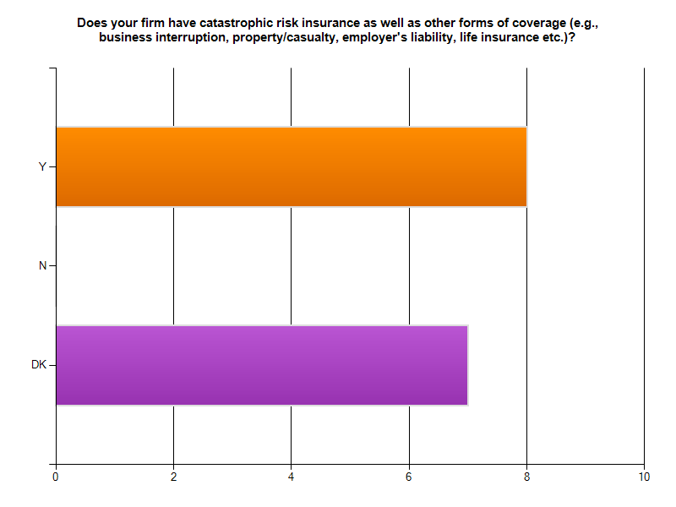
MANY FIRMS ARE COVERED BY CATASTROPHIC RISK INSURANCE

Slide 46
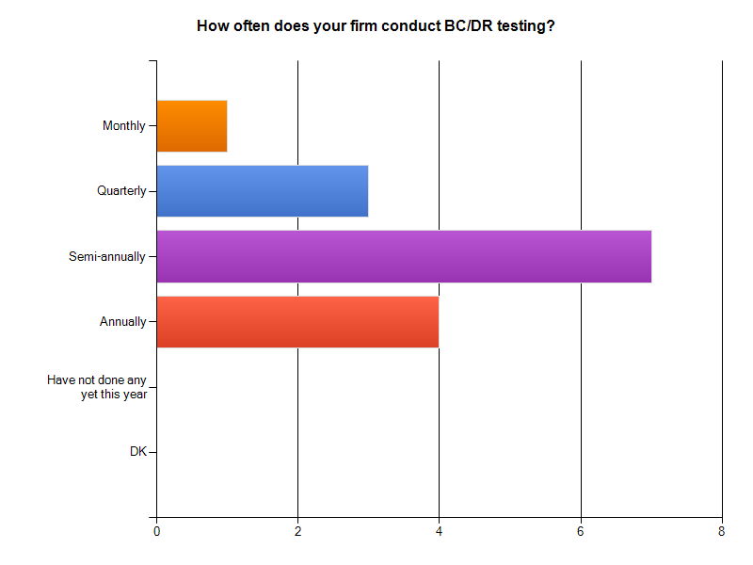
FIRMS TEST THEIR BUSINESS CONTINUANCE CAPABILITIES FREQUENTLY

Slide 47
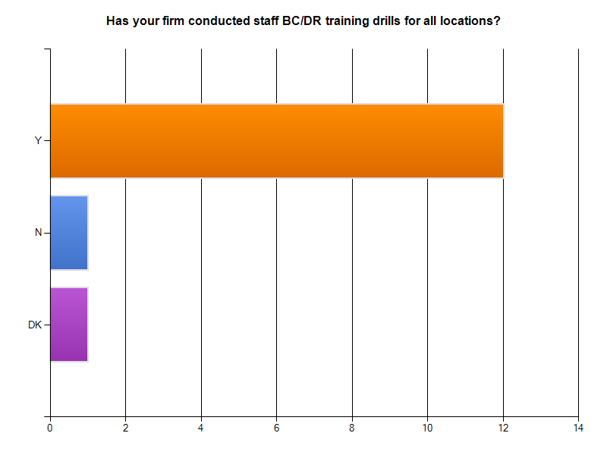
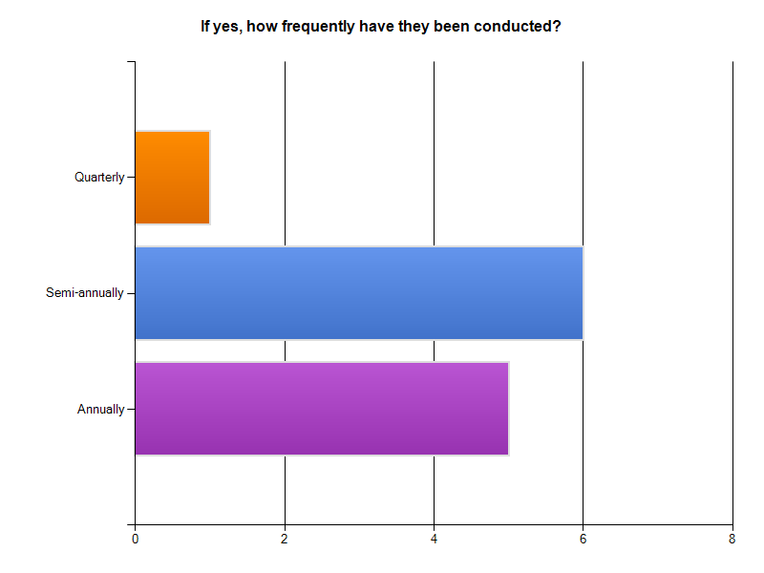
STAFF REGULARLY PARTICIPATE IN BC/DR EXERCISES

Slide 48
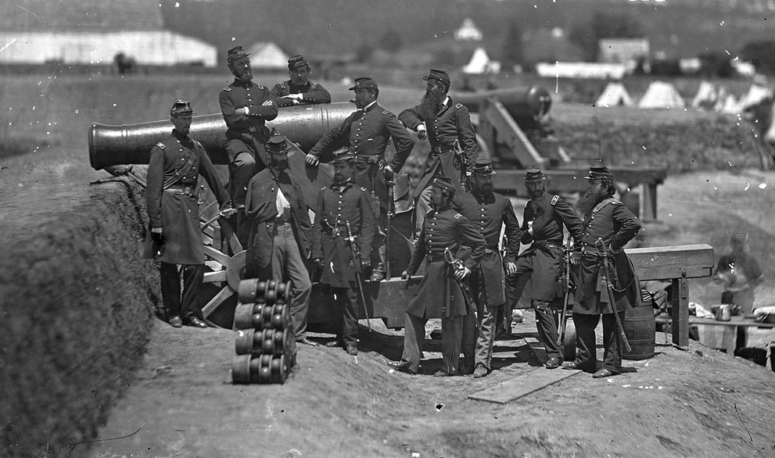
E. LESSONS LEARNED
(Incident Managers Must Continue to be Vigilant…)

Slide 49
LESSONS LEARNED (Cont’d) …
Firms that heeded the storm warnings, communicated early and often, were better prepared and fared well
Regular BC/DR testing of systems, infrastructure and staff paid off
Actions from the authorities to close down mass transit, highways, bridges and tunnels impacted service providers, impeded the movement of key staff, support services
The late decision to close the U.S. equity markets caused confusion, and impacted key investment management operations - but was the right thing to do
Firms are re-evaluating their overall BC/DR preparedness, including the performance of service providers, what worked well, what did not, etc.

Slide 50
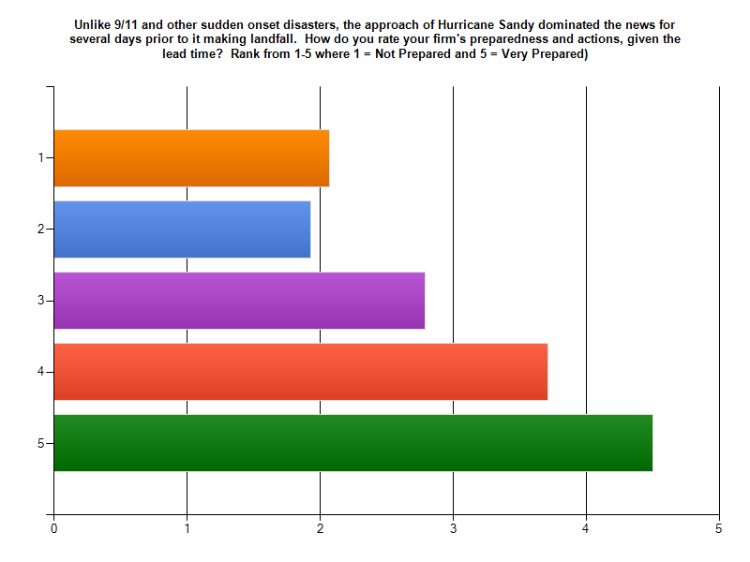
FIRMS TOOK THE FORECASTS SERIOUSLY AND ACTED QUICKLY

Slide 51
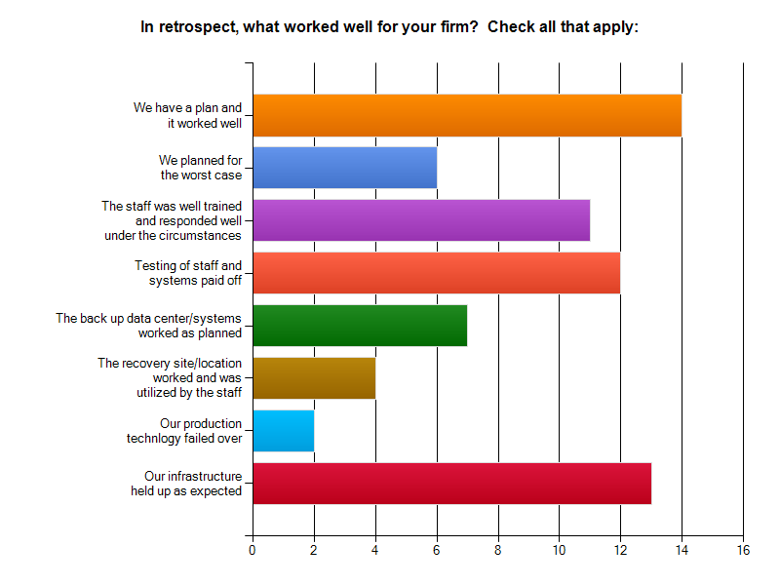
WE HAVE A PLAN, IT WORKED !

Slide 52
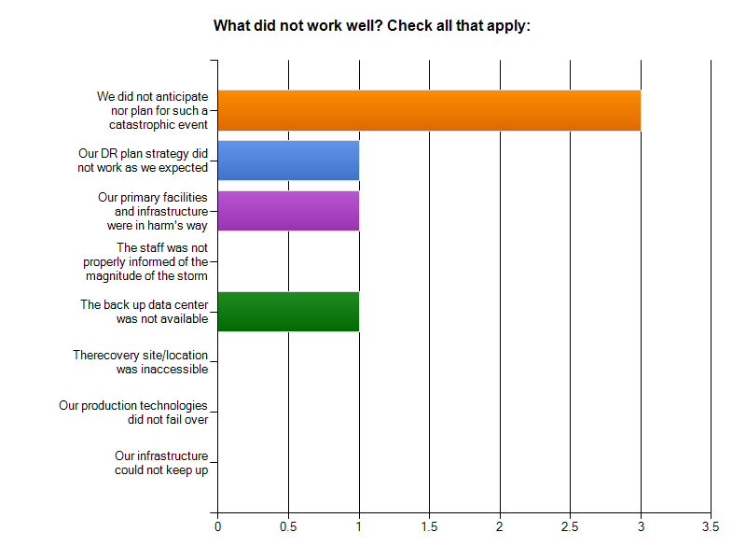
BUT WE DID NOT ANTICIPATE SUCH A WIDESPREAD EVENT WITH MULTIPLE POINTS OF FAILURE!

Slide 53
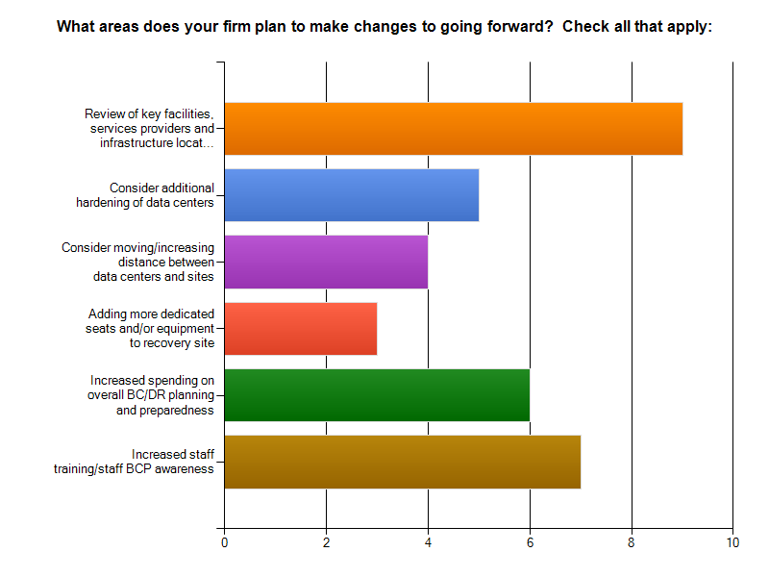
FIRMS ARE ALREADY CONTEMPLATING CHANGES

Slide 54
F. ANECDOTAL FEEDBACK
“We activated our incident management team two days prior to the storm making landfall”
“Our plan worked very well, and we feel very good about how we executed it”
“Everyone was on notice as of Friday and we monitored the situation as the storm made landfall. We communicated with our IMT every 8 to 10 hours to keep everyone informed”
“We did not anticipate that so many users would have to relocate, due to loss of power at home. Those that did could not easily telecommute”
“The biggest impacts were staff's inability to commute, their loss of telecoms, local power outages and road closures”

Slide 55
ANECDOTAL FEEDBACK (Cont’d) …
“We did not anticipate the length and extent of mass transit outages”
“We invoked DR and failed-over our servers in advance of the storm”
“The two biggest missteps in planning for the storm was that our DR site is located less than a mile from the Hackensack River, and relying upon legacy phone circuits to remain untouched”
“We enacted our BCP days prior to the storm by taking the necessary preparedness steps, monitoring the storm etc., however, we did not enact the DR portion of the plan and did not need to fail over”
“Our biggest and least expected surprise was Verizon going down, and not being able to invoke the DR voice plan with VZB”.

Slide 56
ANECDOTAL FEEDBACK (Cont’d) …
“Gas shortages... it was tough to get around, could not get to the DR site/seats because of the state of emergency”.
“Phone circuits went down and some tertiary network circuits. Two of our three primary circuits went down, as well as the primary inbound phone line (including the carrier's switch), so we couldn't redirect inbound phone numbers”
“Our inbound phone numbers came back by 5:30 PM on Friday November 2nd”
“So many staff have replaced their analog phone service with VoIP or broadband packages. After 3-4 hours of the power outage, these people lost phone service. Those who had old copper, analog phone service were hardly affected at all”.

Slide 57
G. CONCLUSIONS

Slide 58
CONCLUSIONS (Cont’d) …
Even the most thoughtful, best tested plans do not contemplate multiple events all going wrong at the same time
Most firms have implemented a resilient infrastructure and a mature business continuance structure and business continuity awareness
Firms were well-prepared, given the advanced warnings and media coverage, but going forward, will need to encourage personal preparedness of staff
Firms enacted their BCP’s coming into the weekend, but only a few needed to failover to DR mode
Those that planned well generally fared well.

Slide 59
CONCLUSIONS (Cont’d) …
Communication with critical staff and decision makers was key to the incident management process.
Few had significant damage to mission-critical systems or infrastructure
Most staff could work remote, however, widespread power outages impeded employees’ telecommuting and collaboration abilities
Employees were unable to leave home due to local storm damage, lack of transportation or unwillingness/inability to leave families.

Slide 60
CONCLUSIONS (Cont’d) …
Many firms leveraged their global offices for support of key business functions
Regular and recent BCP awareness, systems testing and staff training exercises paid off
Firms may re-consider the proximity and locations of their primary and back up facilities, going forward
The biggest problems were caused by supply chain disruptions:
Closure of public transportation
Closure/inaccessibility of key roads
Outages with power and telecomm providers
Inability of staff to commute, telecommute

Slide 61
H. DISCUSSION AND NEXT STEPS
What would your firm have done differently if you only had one day’s notice from the national weather services and the authorities? Would your firm’s outcome have been the same?
What if Sandy came further inland, up the Hudson River?
What if the equity markets opened on Monday?
What if most of Manhattan lost power for a week?
How concerned are you about the proximity and location of your production and DR sites?
Are there areas where firms can collaborate for services or to procure equipment to save money and/or to evaluate best options?

Slide 62
DISCUSSION AND NEXT STEPS (Cont’d) …
Firms should conduct post-mortem evaluations to learn from the experience:
What worked well, what didn’t
Loss of staff’s home computing set ups, telephony
Identify gaps, update plans, processes and technology accordingly
Post-mortem reviews should consider:
Potential vulnerabilities of key service providers, especially cloud service providers DR failover capabilities
Insurance policies for loss of use, flood coverage, etc.
Diversity of telecoms providers, as those relying on 3G/4G networks as a back-up were unsuccessful
Hardening of key staff home set ups.

Slide 63
DISCUSSION AND NEXT STEPS Cont’d) …
Production and DR data center engineering and design should be revisited for:
Redundancy of voice and data infrastructures
Portability of phone systems
The locations of generators and fuel pumps, fuel capacity
Review of fuel supply contracts with multiple suppliers from different routes
The number and location of recovery site seats for key staff.

Slide 64
Be Prepared for The Unexpected Things
That Can Jump Out and Bite You…

Slide 65
Tellefsen and Company, L.LC.
Business Continuity and Advisory Services
1-212 809 3800
info@tellefsen.com
John Rapa Craig Conti
Industry Impact and Lessons Learned From Hurricane Sandy

