Slide 1

SWAP EXECUTION FACILITIES:
MARKET EVOLUTION AND SEF PROFILES
October 2024

Slide 2
The following information was compiled from research and analysis of CFTC submissions, press releases, information obtained in the public domain , interviews with market participants and from information and bulletins contained on the respective Swap Execution Facility (“SEF”) websites.
It is intended to be an overview of the major trading platform providers , inter-dealer brokers and exchanges that operate swap execution facilities. Where available, links to access SEF disclosed volume data are included.
Tellefsen and Company, L.L.C. does not guarantee the accuracy of the content and cannot guarantee completeness, timeliness, or correct sequencing of any of the Information.

Slide 3
I. BACKGROUND AND EVOLUTION OF SWAP EXECUTION FACILITIES
The Dodd-Frank Wall Street Transparency and Accountability Act (“Dodd-Frank”) created a number of environmental impacts on the trading and reporting of securities and commodities based swap transactions
As of October 2, 2013, a number of swap execution facilities (“SEFs”) were granted provisional SEF status. As of Q2 2017, most have been granted full registration status by the CFTC
Tellefsen and Company (“TCL”) has been closely following the evolution of Dodd-Frank legislation and the introduction of various Dodd-Frank Title VII milestones over the last few years
The following pages contain profiles of the various trading platform providers and inter-dealer brokers that have filed for SEF designation.

Slide 4
BACKGROUND AND EVOLUTION OF SEFs (CONT’D) …
SEF business models include dealer-customer and dealer-dealer
Exchanges operate SEFs as designated contract markets (“DCMs”) and offer futures-equivalent products and OTC-like workflows to FCMs and their customers
Most SEF market models are either Limit Order Books (“LOB”) and/or Request for Quote (“RFQ”)
Traditional inter-dealer brokers also operate hybrid markets (voice broker and electronic trading) with RFQ and LOB functions
SEFs have announced interfaces with one or more Derivatives Clearing Organizations (“DCOs”), such as CME, ICE or LCH
A number of SEFs provide public links to their disclosed volume data.

Slide 5
NOT ALL COUNTERPARTIES ARE REQUIRED TO TRADE VIA SEFs
Eligible U.S. persons and non-U.S. persons can or must trade
via SEFs:
Requester | Provider | Must Trade On SEF | Can Trade Off SEF
U.S. Person | U.S. Person | Yes | No
U.S. Person | Non-U.S. Person | Yes | No
Non-U.S. Person | U.S. Person | Yes | No
Non-U.S. Person | Non-U.S. Person | Yes | Yes

Slide 6
KEY CRITERIA FOR SEF SELECTION AND USE
Liquidity, liquidity, liquidity….
Depth of product offerings, asset classes
Compliance with SEF rulebooks and reporting requirements
Linkages to clearing houses and data repositories
Pre-trade credit checking capabilities / links to credit hubs
Ease of workflow for limit order book and RFQ functions
Other value-added functionality and content
Cost

Slide 7
II. ACTIVE SEF MARKETS
The following markets have been granted full registration status from the Commodity Futures Trading Commission to commence trading as of Q4,2024. Dormant and vacated markets are not included.

Slide 8
AEGIS SEF, LLC
Parent Entity: AEGIS Hedging Solutions, Inc.
Business Model: Customer-Dealer
Market Model: LOB and RFQ
Products: Energy, Fuels, Renewables, Metals, Rates
Differentiators: Hybrid Market, API, analytics, STP, compliance reporting
DCO Interfaces: N/A
SDR Interfaces: DTCC, ICE Trade Vault
Link to Disclosed Volume Data: N/A

Slide 9
BGC DERIVATIVES MARKETS, LP
Parent Entity: BGC Partners
Business Model: Dealer-Dealer
Market Model: Hybrid – Voice and Electronic Trading;
LOB and RFQ
Products: Credit, Energy, Equities, FX, Metals, Rates
Differentiators: Hybrid Market, Daily Auctions, FIX API, STP
DCO Interfaces: CME, ICE, LCH
SDR Interfaces: DTCC
Link to Disclosed Volume Data: http://dailyactprod.bgcsef.com/SEF/DailyAct/

Slide 10
BLOOMBERG SEF, LLC
Parent Entity: Bloomberg, LP
Business Model: Dealer-Customer
Market Model: LOB and RFQ
Products: Credit, FX, Rates, Commodities
Differentiators: Pre-Trade Credit Checking, Accessible via Bloomberg Workstations
DCO Interfaces: CME, ICE, LCH
SDR Interfaces: N/A, T-B-D
Link to Disclosed Volume Data: http://data.bloombergsef.com/

Slide 11
Cboe SEF, LLC
Parent Entity: Cboe Global Markets
Business Model: Dealer-Customer
Market Model: Hybrid Voice/ETS. LOB and RFQ
Products: FX NDFs
Differentiators: Block Trades, CTT, STP
DCO Interfaces: CME, LCH
SDR Interfaces: N/A, T-B-D
Link to Disclosed Volume Data: https://www.cboe.com/global/fx/sef/volume/

Slide 12
CLEAR MARKETS NORTH AMERICA INC.
Parent Entity: Clear Markets Holdings, Inc.
Business Model: Dealer-Customer
Market Model: LOB, RFQ, RFI
Products: Interest Rate Swaps, Credit
Differentiators: Blocks, FRAs, OIS, Spreads, Butterflies
DCO Interfaces: N/A, T-B-D
SDR Interfaces: DTCC
Link to Disclosed Volume Data: https://www.clear-markets.com/cm-sef-centre/

Slide 13
DW SEF, LLC
Parent Entity: TradeWeb
Business Model: Dealer-Dealer
Market Model: LOB
Products: Cash Settled Credit, Rates
Differentiators: STP
DCO Interfaces: CME, ICE, LCH
SDR Interfaces: N/A
Link to Disclosed Volume Data: http://www.tradeweb.com/Institutional/Derivatives/SEF-Center/

Slide 14
FTSEF, LLC
Parent Entity: FlexTrade
Business Model: Dealer-Customer
Market Model: LOB, RFQ
Products: FX, Rates
Differentiators: Pre-Trade Credit Controls, Trade Compression and Unwind Functions, Cash Settled Futures Swap Products, Swap and Invoice Spreads
DCO Interfaces: N/A
SDR Interfaces: DTCC
Link to Disclosed Volume Data: https://flextrade.com/swap-execution-facility/

Slide 15
GFI SWAPS EXCHANGE, LLC
Parent Entity: BGC Partners/GFI
Business Model: Dealer-Dealer
Market Model: Hybrid Voice/ETS. LOB and RFQ
Products: Credit, FX, Rates
Differentiators: Workup, FIX, FIXML, Excel for STP
DCO Interfaces: CME, ICE, LCH
SDR Interfaces: CME, DTCC
Link to Disclosed Volume Data: http://www.gfigroup.com/markets/swaps-exchange/trade-data.aspx

Slide 16
ICAP SEF (US), LLC
Parent Entity: TP-ICAP Plc.
Business Model: Dealer-Dealer
Market Model: Hybrid Voice/ETS. LOB and RFQ
Products: Credit, Equities, FX, Rates
Differentiators: Workup Trades, Combination Trades, Block Trades, STP to Clearing
DCO Interfaces: CME, ICE, LCH
SDR Interfaces: N/A
Link to Disclosed Volume Data:
http://www.icap.com/markets/swap-execution-facility/market-data.aspx

Slide 17
ICAP GLOBAL DERIVATIVES LTD.
Parent Entity: TP-ICAP Plc.
Business Model: Dealer-Dealer
Market Model: Hybrid Voice/ETS. LOB and RFQ
Products: Rates
Differentiators: Workup Trades, Combination Trades, Block Trades, STP to Clearing
DCO Interfaces: CME, ICE, LCH
SDR Interfaces: N/A
Link to Disclosed Volume Data:
http://www.icap.com/markets/swap-execution-facility/market-data.aspx

Slide 18
ICE SWAP TRADE LLC
Parent Entity: IntercontinentalExchange Group
Business Model: DCM
Market Model: Hybrid Voice/ETS. LOB and RFQ
Products: Credit
Differentiators: Block Trades, STP via FIX API, Voice Trading via Creditex
DCO Interfaces: ICE
SDR Interfaces: ICE
Link to Disclosed Volume Data: https://www.theice.com/swap-trade

Slide 19
LATAM SEF
Parent Entity: N/A
Business Model: N/A
Market Model: N/A
Products: Mexican Peso, IRS
Differentiators: N/A
DCO Interfaces: CME, LCH
SDR Interfaces: DTCC
Link to Disclosed Volume Data: http://latamsef.com/marketactivity.phtml

Slide 20
LEDGERX, LLC
Parent Entity: Ledger Holdings, LLC
Business Model: N/A
Market Model: N/A
Products: FX, Alternative Commodities, Bitcoin Options
Differentiators: N/A
DCO Interfaces: Ledgerex DCO (TBD)
SDR Interfaces: ICE Trade Vault
Link to Disclosed Volume Data: N/A

Slide 21
RTX FINTECH & RESEARCH, LLC
Parent Entity: RTX Holdings, Inc.
Business Model: Dealer-Dealer
Market Model: ETS. LOB and RFQ
Products: FX NDFs
Differentiators: STP to Clearing
DCO Interfaces: CME, LCH
SDR Interfaces: N/A
Link to Disclosed Volume Data: N/A

Slide 22
SPECTREAXE LLC
Parent Entity: SpectrAx LLC
Business Model: Dealer-Customer
Market Model: LOB
Products: FX Options
Differentiators: Pre-Trade Credit Checking
DCO Interfaces: N/A
SDR Interfaces: N/A
Link to Disclosed Volume Data: https://www.spectraxesef.com/tradedata

Slide 23
360 TRADING NETWORKS, INC.
Parent Entity: Deutsche Borse AG
Business Model: Dealer-Customer
Market Model: N/A
Products: FX NDFs, NDS, Rates
Differentiators: Counterparty Relationship Management Tool, Block Trades, API for STP to Clearing
DCO Interfaces: CME
SDR Interfaces: DTCC
Link to Disclosed Volume Data: https://download.360t.com/sef_reporting/SEF_trade_data.pdf

Slide 24
LSEG FX SEF, LLC
Parent Entity: Refinitiv
Business Model: Dealer-Customer
Market Model: LOB
Products: FX NDFs and Options
Differentiators: STP, Multibank RFS
DCO Interfaces: N/A
SDR Interfaces: DTCC
Link to Disclosed Volume Data:
http://www.fxall.com/solutions--capabilities/regulatory-solutions

Slide 25
TP SEF, LLC
Parent Entity: TP-ICAP (Tullett Prebon)
Business Model: Dealer-Customer
Market Model: Hybrid Voice/ETS. LOB and RFQ
Products: Credit, Energy, Equities, FX, Rates
Differentiators: STP to Clearing
DCO Interfaces: CME, ICE, LCH
SDR Interfaces: CME, DTCC, ICE Trade Vault
Link to Disclosed Volume Data: https://www.tullettprebon.com/swap-execution-facility/daily-activity-summary.aspx

Slide 26
TRADITION SEF
Parent Entity: Compagnie Financiere Tradition
Business Model: Dealer-Dealer
Market Model: Hybrid Voice/ETS. LOB and RFQ
Products: Credit, FX, Rates
Differentiators: STP to Clearing
DCO Interfaces: CME, ICE, LCH
SDR Interfaces: DTCC
Link to Disclosed Volume Data: http://www.traditionsef.com/market-activity/

Slide 27
TW SEF, LLC
Parent Entity: TradeWeb Markets, LLC
Business Model: Dealer-Customer
Market Model: LOB and RFQ
Products: Cash Settled CDS, IRS
Differentiators: Pre-Trade Credit Checking, Compression for up to 200 Swap Positions, STP
DCO Interfaces: CME, ICE, LCH
SDR Interfaces: N/A
Link to Disclosed Volume Data: (Via authorized login):
http://www.tradeweb.com/Institutional/Derivatives/SEF-Center/

Slide 28
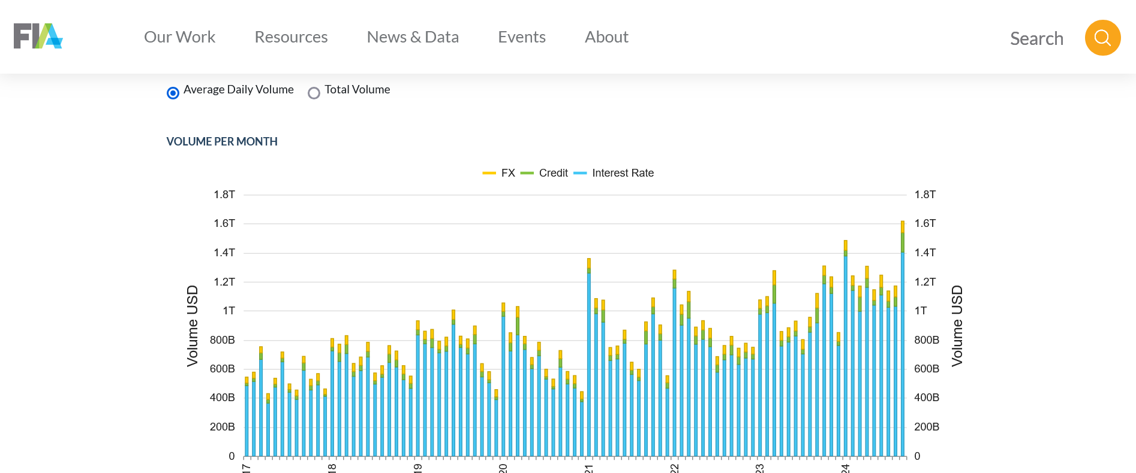
III. AVERAGE DAILY VOLUMES PER MONTH - 2017 TO DATE
Source: Futures Industry Association October 2024

Slide 29
IV. THORNY ISSUES REMAIN …
Compliance requirements are consuming perspective SEF buy-side participants and are throttling the on-boarding process (e.g., the extent of the documentation review and internal sign-off process)
There are marked differences across the various SEFs rulebooks
The process for give-ups and allocations has not been resolved
There are indemnification and liability issues associated with direct market access.

Slide 30
THORNY ISSUES REMAIN (Cont’d) …
The resolution of rejected trades has numerous legal, financial and compliance implications
There are issues with pre and post-trade certainty of execution and guaranty of clearing of swaps (e.g., compliance with CFTC Rules 1.73, 1.74).
There are multiple approaches to pre-trade credit checking (e.g., ping, push or via credit hubs), no one size fits all
Clearing certainty is a challenging problem – need for credit checks of all counterparties (2xcustomer side) and FCMs (2xstreet side ) versus the clearing house
The ability to research/review/reconstruct which specific trades were done on which SEFs, via SDRs still remains challenging.

Slide 31
THORNY ISSUES REMAIN (Cont’d) …
Dodd-Frank has made it more challenging to trade swaps vs. futures, contributing to the low SEF volumes (e.g., EU clients trading with the EU units of global banks are doing more off-SEF trades than on-SEF, because of the complexities and costs)
Cross-border regulation – the transaction level requirements for U.S. persons versus non-U.S. persons – is there a potential for regulatory arbitrage?

Slide 32
V. GOING FORWARD …
Trading volumes are low in certain products, due in part to the low adoption rate by buy-side firms, operational challenges, lingering open issues and the keyhole effect caused by internal reviews/sign off on SEF documentation
Trading volume trajectory has been driven mainly by plain vanilla swaps; certain institutions that trade packages versus treasuries are still holding back.
There are numerous problems still being discussed – the unintended consequences of Dodd-Frank Title VII – we believe they will be resolved in the short-medium term

Slide 33
GOING FORWARD (Cont’d) …
The adage that “liquidity begets liquidity” and the depth of product or asset class offerings will be two of the top criteria that will attract firms to utilize SEF platforms versus swap futures
The SEF landscape will change, as new cleared and non-cleared products are introduced and traded and SEFs build market share
There will be advantages to the first movers… and opportunities…

Slide 34
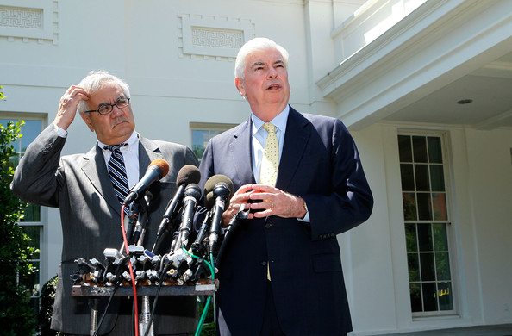
STILL CONFUSED ABOUT
DODD-FRANK?
SEF, Schmeff… I’m Chris, He’s Barney ….

Slide 35

Contact Us for More Market Insight!
Tellefsen and Company, L.LC.
1-212 809 3800
JJR@Tellefsen.com

