Slide 1
High Frequency Trading Overview
Q1 2020

Slide 2
Intro
In response to the recent media hype surrounding Michael Lewis’ book “Flash Boys”, we have created this synopsis of high frequency trading (HFT)
The synopsis includes background from the unintended consequences of SEC’s Reg NMS, issues, the pros and cons of using ATS “dark pools”, key HFT players, an overview of HFT technology components
We also provide our views and opinions on HFT and where the industry is going.

Slide 3
Background
Reg NMS (post decimalization) in 2005 requires exchanges and dark pool ATS to compete on price within the National Best Bid/Offer (NBBO)
Intended to create a level playing field between exchanges and dark pools, lowered the bid/asked spread
The concept of “fast markets versus slow markets”; created a racing effect
Most ATS dark pools created 2005-2007, post the implementation of Reg NMS
Price competition results in high rates of orders/cancels and routing away to other venues by HFT players, as the NBBO changes and they seek the best bids/offers
Ramped up since 2005, Reg NMS moved some responsibilities from specialists and market makers to buy and sell-side traders.

Slide 4
Background (Cont’d) …
The “Law of Unintended Consequences” – Reg NMS created a highly fragmented market, potentially subject to gaming
Today there are 14 equity exchanges, 16 options markets and 45+ dark pool ATS, based on their liquidity and market share
The SEC has micro-managed Reg NMS regulations and compliance; they say that exchanges must treat the same classes of users consistently
Exchanges have become technology providers, and now offer proximity hosting (co-location) services as a new, premium priced service
There is a limited audience of HFT and DMM firms that can afford a “premium seat”; there has been consolidation as a result of lower transaction volumes, cost pressures have pushed the marginal players out of the market.

Slide 5
Background (Cont’d) …
Exchange technology services have quickly evolved into profit centers
Co-lo services have fixed/variable costs (e.g., most co-lo contracts are ~24 months long)
Payment for order flow (PFOF) incentives by exchanges, potential conflicts with firms’ “best execution” responsibilities
But, best ex is not required for unsolicited, directed order flow to a specific venue
The impact of HFT on “informed” order flow versus “non-informed” order flow; resting order flow versus transitory flow.

Slide 6
Background (Cont’d) …
HFT has traditionally involved latency arbitrage and liquidity provision:
Executing “non-toxic” orders faster and at better prices than the BBO
Rejecting the toxic flow.
Arbitrage has since become highly efficient and has almost disappeared.
HFT firms are constantly fine tuning their SW/HW and co-location capabilities.
But the cost of these have since come in line with their values.

Slide 7
Issues
Connectivity to a growing number of execution venues adds cost, complexity and increased regulatory burdens to buy-side and sell-side firms
Preferencing of orders via smart order routing, algo logic.
Latency arbitrage opportunities – trading ahead of index re-balancing, economic/corporate news releases, social media “chatter”, event arbitrage, stat arb – are almost gone.
Some platforms have had more latency than others (e.g., the distance between firms, co-lo sites and the matching engine; matching engine design optimization; communications speeds/laws of physics)
Latency differences at trading venues between order entry/execution systems and SIP (central market data) reporting.

Slide 8
Issues (Cont’d) …
Gaming of orders, spoofing markets, layering of order methods to prevent/retard gaming (e.g., display names and size only, display names and side only); lock out the bad actors
Penny jumping, sweeping the book, sub-penny churn of ETF arbitrage and client order flow
Inconsistency in the controls used to manage the trading processes and procedures across the various venues
The business and technical ramifications of when things all go wrong at the same time:
Flash Crash 2010
Knight Capital Rogue Algo, Incompatible Software
Hash Crash 2013

Slide 9
Issues (Cont’d) …
Potential for spikes in volatility if market makers cannot stabilize prices within the minimum spread
Need for well-developed processes and procedures, error account liability
Most of the low hanging fruit has already been picked!

Slide 10
The Players
HFT firms include prop trading firms, Designated Market Makers (DMMs), buy-side and sell-side firms
Technology innovators, early adopters; followers and laggards
Prop trading firms – flow traders looking for an edge
Scalpers, day traders
Transitory order flow
“Like picking up pennies in front of a fast moving steam roller”
Many trade intra-day with high, intra-day VaR, low regulatory capital
Market making firms – have contractual obligations with exchanges
Provide resting and transitory order flow
Sell-side brokers
Agency order flow providers with resting order flow.

Slide 11
The Players (Cont’d) …
Players have included Allston Trading, Citadel Securities, DRW Trading, Flow Traders, Goldman Sachs, GTS, Hudson River Trading, IMC Financial Markets, Jane Street, Jump Trading, Millennium, Morgan Stanley, Optiver, Susquehanna International Group, Tower Research Capital, Tradebot, Two Sigma, UBS, Virtu Financial, XR Trading*
*There has been consolidation, and several of these firms have exited the HFT business, due to the lack of volatility and the impact to profitability.
As profitability has contracted, many have moved on from equities into other asset classes and less liquid markets (FX, futures, emerging markets bonds).
Crypto currencies are also emerging as a new playing field. Stay tuned…

Slide 12
HFT – Technology Components
ULLDMA Technologies:
Co-located servers, proximity hosting with exchange/ATS matching engines
Algos to slice and dice block sized orders, smart order routing to venue(s) with the prevailing NBBO or size liquidity
Subsets and core components of HFT
Ability to consume and digest a large volume and velocity of “big data” (structured and unstructured real time market data, news, social media chatter)
Evolution of new order types
Variations on LMT, IOC, FOK etc.
Use of high-speed networking, hardware and software technologies.

Slide 13
HFT – Technology Components (Cont’d) …
Fiber network connectivity for speed advantages to address/mitigate and extract latency arbitrage
Evolution of microwave communications between east coast and mid-west exchange co-lo sites for further speed edge
Specialized FIX connectivity to
~65 equity exchanges/ATS dark pools
8-10 futures exchanges
~20 FX networks/ECNs
Specialized, continually-tuned software engineering and related tech architecture expertise
Capex requirements for equipment purchases
Build outs can take several months or longer.

Slide 14
HFT Growth Rate*
Early 2000’s: <10% U.S. equities
164% CAGR from 2005-2009
By 2016, ~52% of U.S. equity order flow; ~60% of U.S. futures order flow
*Source: New York Stock Exchange, Tabb Group

Slide 15
Decline in HFT Profitability, Downward Margin Pressures
Low volatility, declining transaction volumes; effects of de-leveraging, capital adequacy constraints on market making, prime brokerage activities
High barriers to market entry (capex expenditures, IT infrastructure investment, specialized trading, software engineering and tech infrastructure expertise)
Escalating IT and regulatory compliance costs
HFT-like technologies are now embedded in market structure.
Profit margin decline from ~10 mils/share in 2008 to ~5 mils/share in 2013
Getco’s HFT profit fell 90% in 2012/2011; they exited the HFT business in Feb 2013.

Slide 16
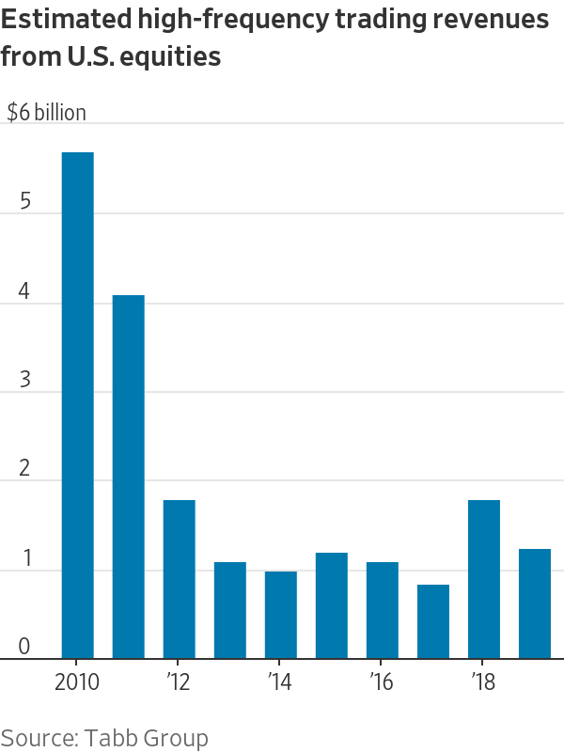
U.S. Equities HFT Revenues - Continued Decline; Spread Across Numerous Firms

Slide 17
Pro’s / Con’s of Dark Pools
PROs
Multiple liquidity pools, places to source liquidity
Some offer anonymous block trading
Support for multiple, new order types to facilitate HFT
Gives buy-side traders more control, choices for execution
Preferencing of orders via algo routing to specific venues
Internalization of order flow: a smorgasbord of block, retail, institutional, prop, market making orders
Latency advantages/disadvantages between exchanges, ATS venues
CONS
Internalization of order flow by large “wholesalers”
Levels of complexity and responsibilities for the buy-side in achieving Best Ex
Potential for information leakage and gaming
Latency advantages/disadvantages
Custom order types can become “toxic”
Payment for order flow
Some of the smorgasbord of order flow can be considered “toxic”

Slide 18
Implicit / Explicit Trading Costs
Traditional slippage, market impact costs (latency)
Market impact costs in handling block flow versus retail/small order flow
Floor brokerage and commissions
Rebate fees
Exchange fees including the premium costs for proximity hosting of servers in co-lo sites
The impact of informed versus un-informed order flow
Transaction cost analysis (TCA) tools now available in the public domain.

Slide 19
Maker/ Taker Fees, Ranges
Varies from venue to venue
Fees vary from the buy-side and the sell-side (i.e., some fees may not be passed along to buy-side, others are passed along to the sell-side)
Equities:
Makers: 0-15 mils/share
Takers: 15-40 mils/share
Options:
Makers: 0-44 mils/contract
Takers: 10-50 mils/contract
PLUS:
Routing fees of 25-50 mils/share

Slide 20
Our Opinion
HFT firms exploited a loophole in Reg NMS, an unintended consequence, creating a technology arms race
Not all HFT is bad, but there have been some bad actors
Reg NMS, fueled by HFT, has resulted in compressed spreads, making it cheaper for retail investors in the long term
Market makers have had to embrace, adopt HFT technologies and business models to support their DMM obligations, defend their profitability and keep up with speed and tech arms race
Flash crashes are fueled by HFT (like fire is by wind), and are caused by poorly tested/designed algos and lack of experienced trading professionals and operational risk procedures.

Slide 21
Our Opinion (Cont’d) …
Most of the low hanging fruit has already been picked and HFT profitability is down sharply.
Few, if any new (prop) players are entering this market, due to the high barriers to entry.
This racing effect produces questionably predictive profit seeking opportunities for prop trading firms.
Firms trading for the rebates will have to find a new way to make money (or exit the business), as maker-taker and taker-maker business models will be under heavy regulatory scrutiny; exchanges may be forced to greatly revise or scrap them.
We believe there are, at best, ~25 prop trading firms that are making money at HFT today.

Slide 22
Our Opinion (Cont’d) …
The game has changed from pure speed to finding underpriced latency.
HFT firms will need the skills to find things that are underpriced and negotiate with the exchanges and counterparties.
HFT today, carries more cost, risk and capital commitment than the old-fashioned FT.
Shifting regulatory reform of HFT will impact exchanges business models and grind into their cost structures, as co-location and taker-maker revenues compress
Co-lo hosting providers, communications and related HFT services providers will also be potentially impacted by regulatory changes.

Slide 23
Our Opinion (Cont’d) …
HFT firms will face technology problems, going forward, that will require deep knowledge of the mechanics of the markets.
As HFT firms seek opportunities in less liquid names, structured products and derivatives, it will he harder to get information about orders and transactions.
As a result, they my be required to hold positions for days, weeks or longer before the other side comes to the market.
This will result in higher capital commitment and the need to do more hedging.

Slide 24
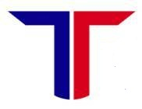
For More Info on HFT Directions:
Tellefsen and Company, L.LC.
1-212 809 3800
JJR@Tellefsen.com

